Slide 1
World War I: Leaders and Propaganda

Slide 2
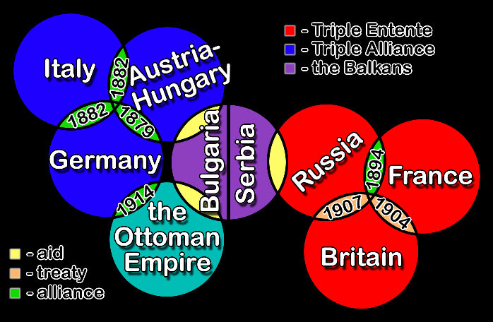
Alliance System
Alliance system shaped the two sides of the war.
Balkan Peninsula was referred to as the Powder Keg.
Tensions were high
Anything could spark a disaster
Triple Entente | Triple Alliance
Great Britain | Germany
France | Austria-Hungary
Russia | Ottoman Empire

Slide 3
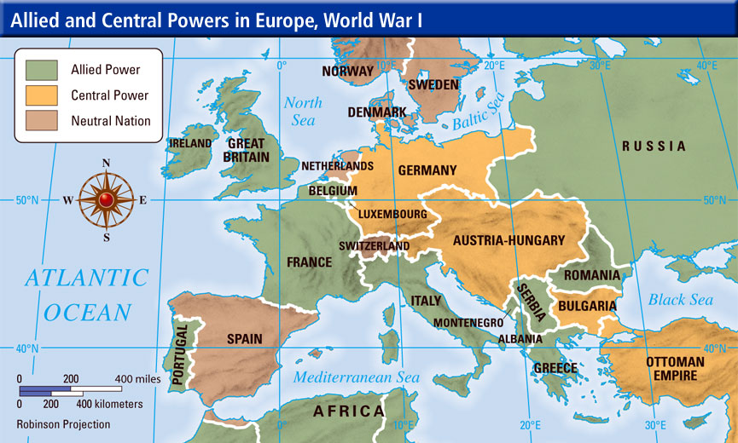
Two Sides of the War
Allied Powers | Neutral | Central Powers
Britain France Italy Russia United States | Switzerland Spain Norway Sweden Denmark | Germany Austria-Hungary Ottoman Empire Bulgaria

Slide 4
Leaders of the Allied Powers
Britain: King George V
1914-1918
France: President Raymond Poincare
1914-1918
Russia: Tsar Nicholas II
1914-1917
Italy: King Victor Emmanuel III
1914-1918
United States: President Woodrow Wilson
1917-1918

Slide 5
Leaders of the Central Powers
Austria-Hungary: Emperor Franz Joseph
1914-1918
Germany: Emperor Wilhelm II
1914-1918
Ottoman Empire: Sultan Mehmed V
1914-1918
Bulgaria: Tsar Ferdinand I
1914-1918

Slide 6
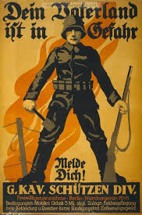
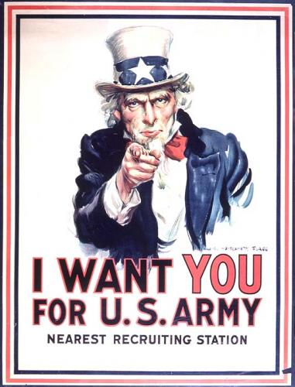
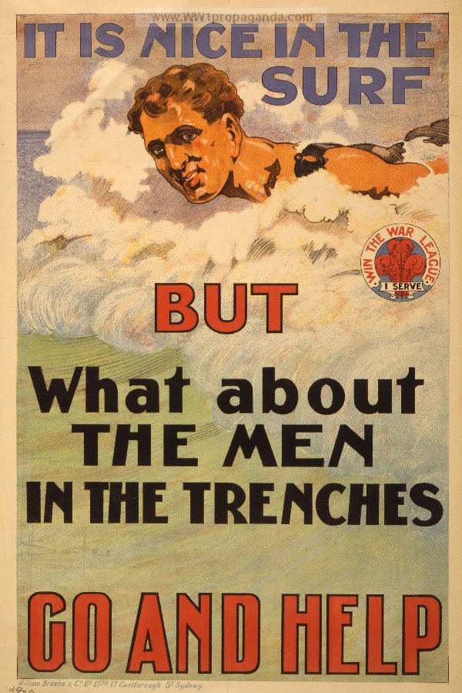
Propaganda
Definition: information, especially of a biased or misleading nature, used to promote or publicize a particular political cause or point of view.
Example: armed services posters distributed by the government.
Used during WWI to support war cause.

Slide 7
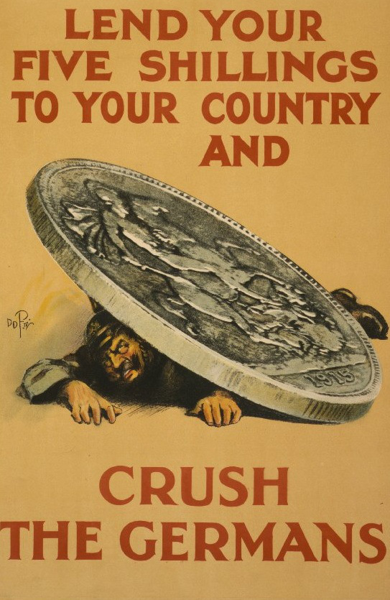
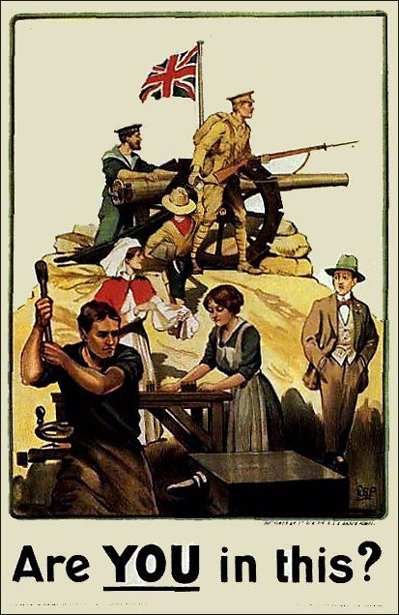
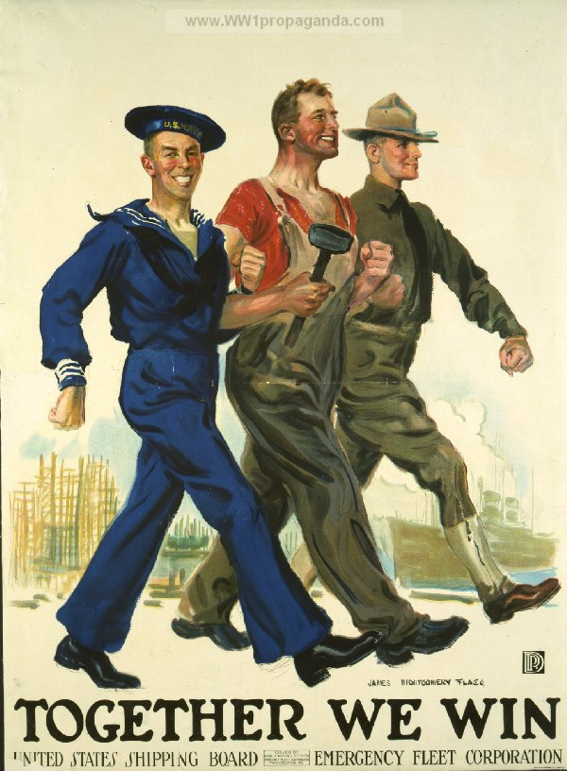
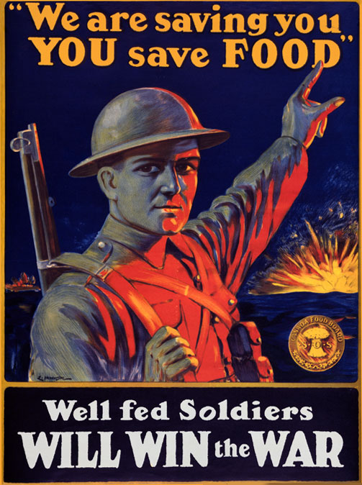
Total War
Definition: a war in which a nation’s full financial resources are devoted to the war effort.
WWI became a total war when participating countries began devoting all of their resources to the war.
Often promoted with propaganda.

