Slide 1
End of World War I

Slide 2
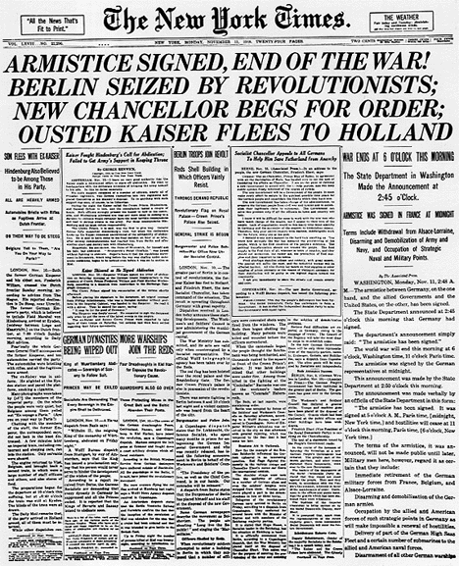
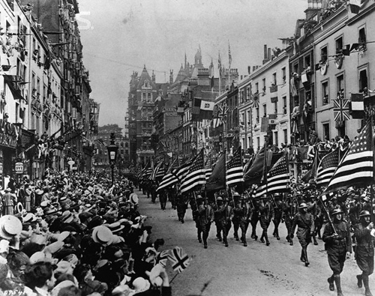
Armistice
Definition: an agreement made by opposing sides in a war to stop fighting for a certain time.
Signed November 11th, 1918
Veterans Day
War isn’t officially over just yet.

Slide 3
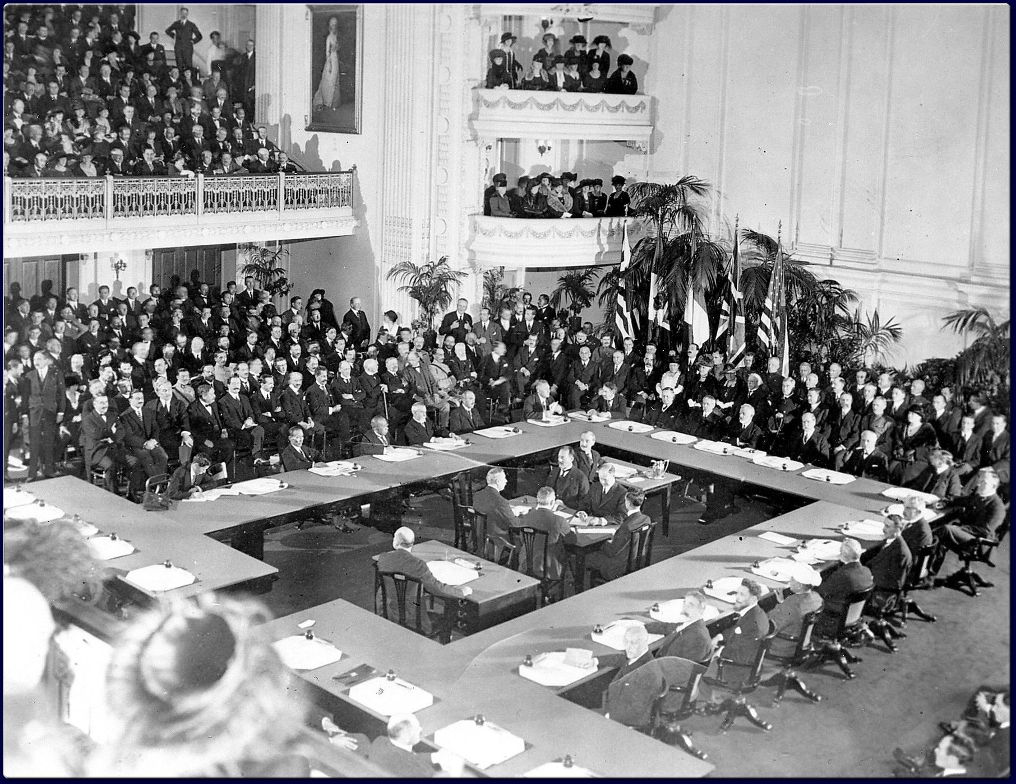
Paris Peace Conference, 1919
Meeting of Allied victors to set official peace terms.
Diplomats present from more than 32 countries.
President Woodrow Wilson
14 Points: Wilson’s plan for the postwar world
Two major outcomes of the conference
League of Nations
Treaty of Versailles

Slide 4
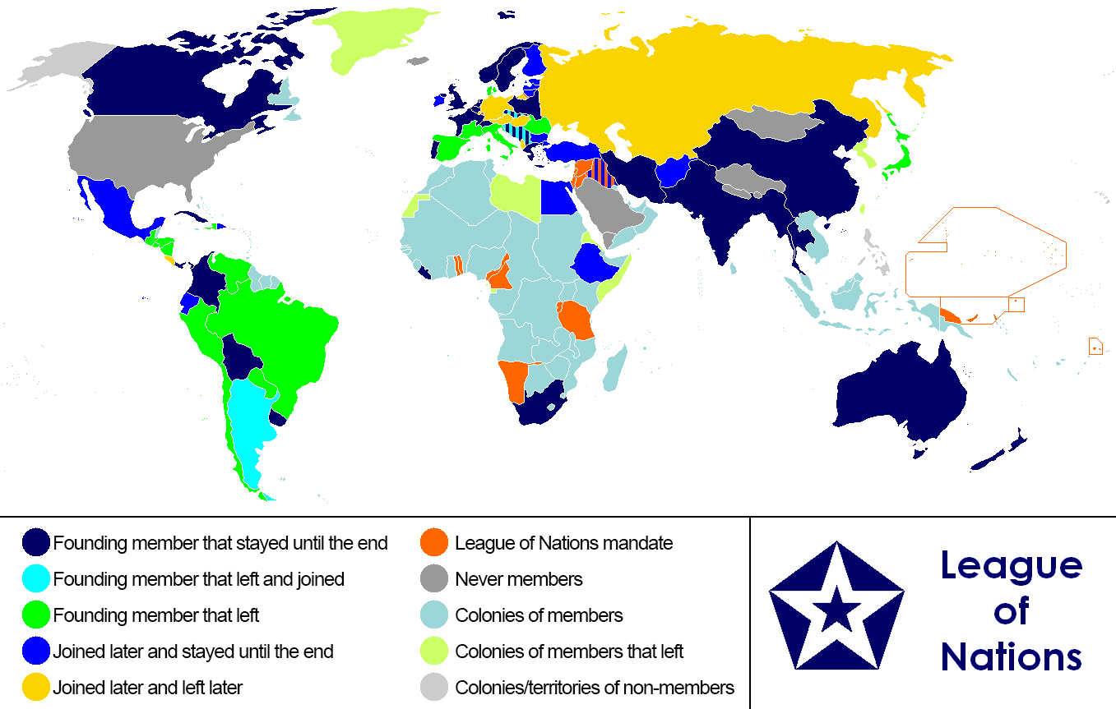
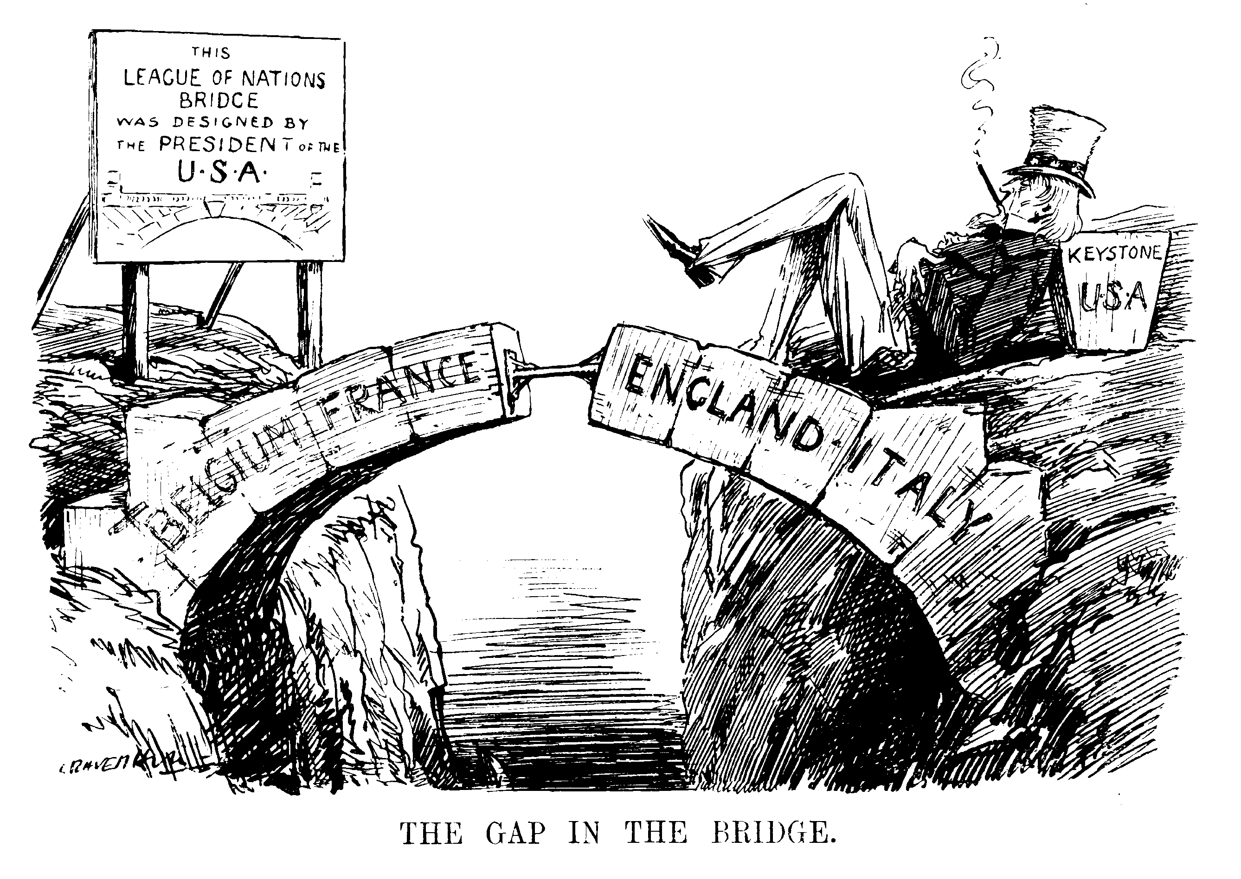
The League of Nations
An international organization created to provide a forum for resolving international disputes.
Mission was to maintain world peace.
League failed in its mission.

Slide 5
Treaty of Versailles
June 28th, 1919: Formally ends WWI
Central powers had no say in the treaty’s provisions.
Article 231, The War Guilt Clause, forced Germany to…
Accept full blame for the war
Pay the equivalent of $422 billion
Completely disarm its military
Give up substantial amounts of land
Replace imperial gov with Weimar Republic

Slide 6
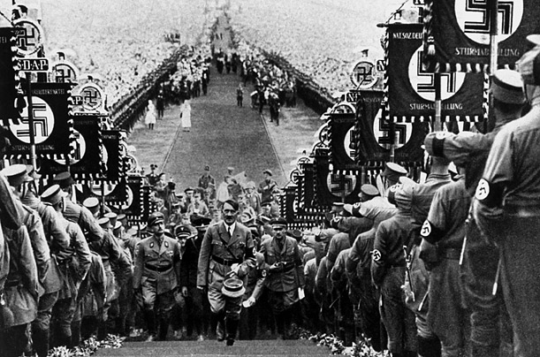
Versailles Fallout
German economy crashes
Rise of frustrated, fanatical, German nationalists
Adolf Hitler and the Nazi Party
Overthrow of the Weimar Republic
Establishment of the Third Reich
Outbreak of World War II

