Slide 1
Capitalism vs. Socialism

Slide 2
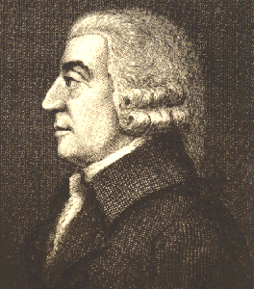
Capitalism
Founder: Adam Smith
Private ownership of business and property
Competition: encouraged

Slide 3
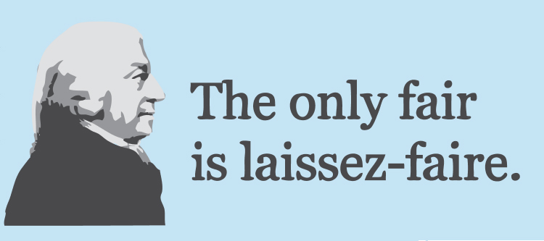
Capitalism
Goal: Private business to compete
Laissez Faire: abstention by governments from interfering in the workings of the free market

Slide 4
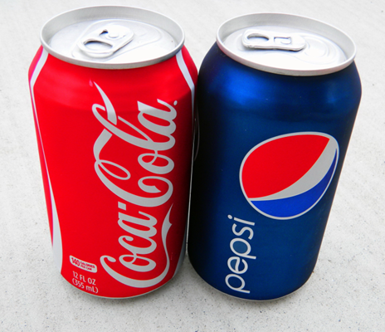
Capitalism
Private businesses compete to produce the best products and services for consumers.
The free market can solve economic problems through competition and free trade.

Slide 5
Capitalism
Pros
Competition encourages innovation
Economic incentives
Economic freedom
Cons
Unequal distribution of wealth
Boom and bust cycles
Monopoly power

Slide 6
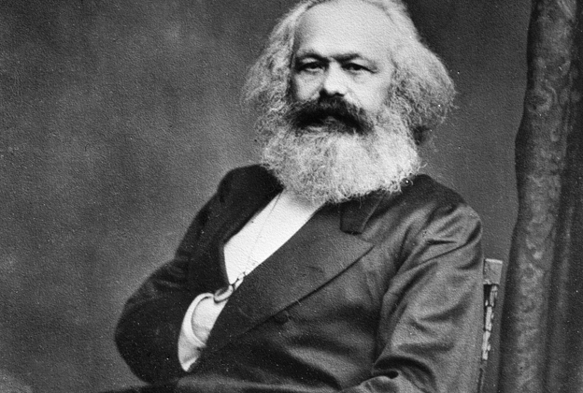
Socialism
Founder: Karl Marx
Government ownership of business and property
Competition: discouraged

Slide 7
Socialism
Goal: classless society
Proletariat: workers, or working-class people, regarded collectively.

Slide 8
Socialism
Economic system based on equality that would provide guaranteed healthcare, housing, jobs, educations, and pensions for all citizens.
To carry out these costly public benefits, government would own the property and wealth of a nation and put them to use for the common good.

Slide 9
Socialism
Pros
Social equality
Economic equality
Medical equality
Cons
Lack of competition
Few economic incentives
Government oversight

Slide 10
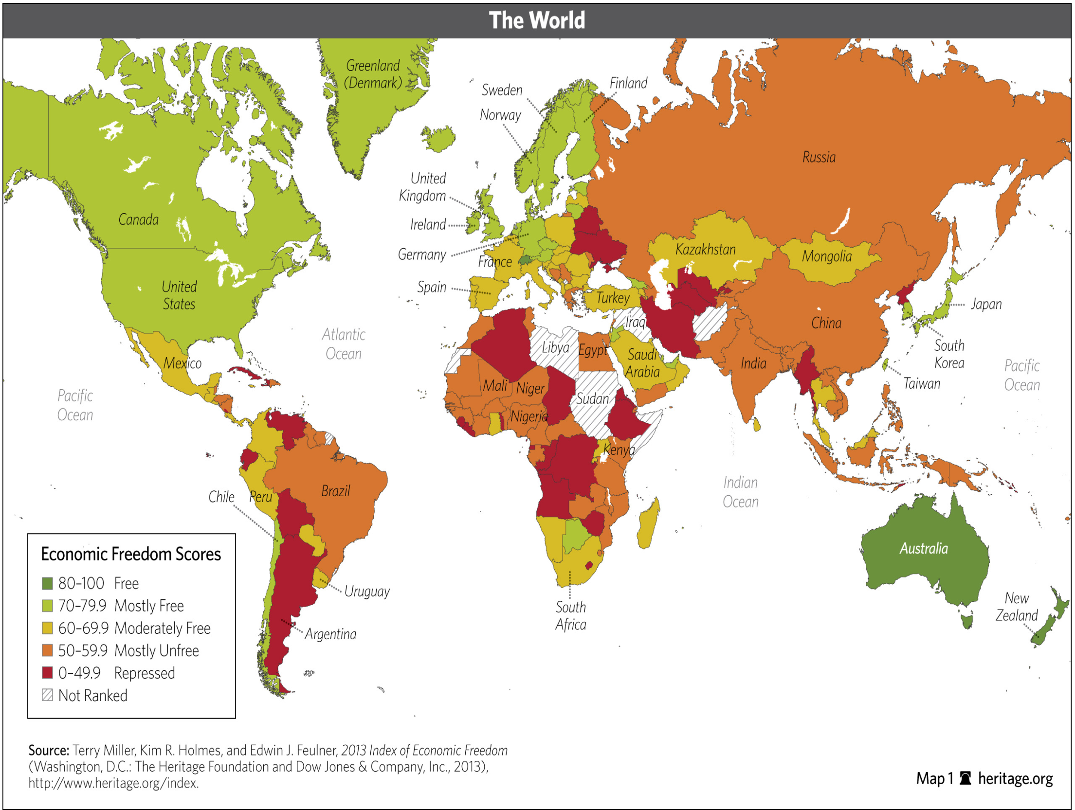

Slide 11
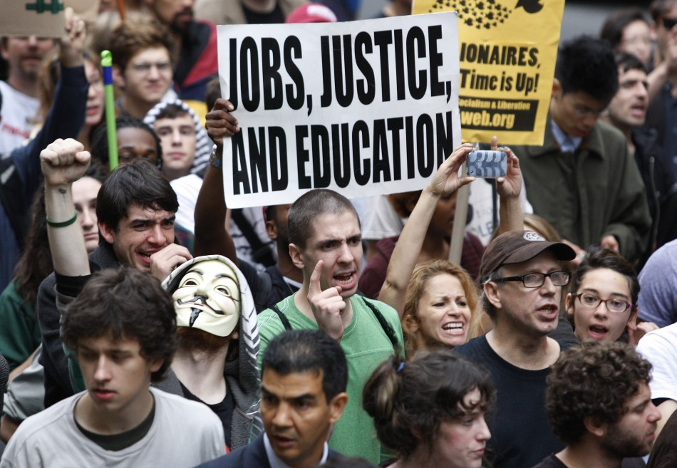
Marx’s Theory
Capitalism →
Class Struggle →
Worker’s Revolt → Socialism →
Communism

