Slide 1
End of WWII

Slide 2
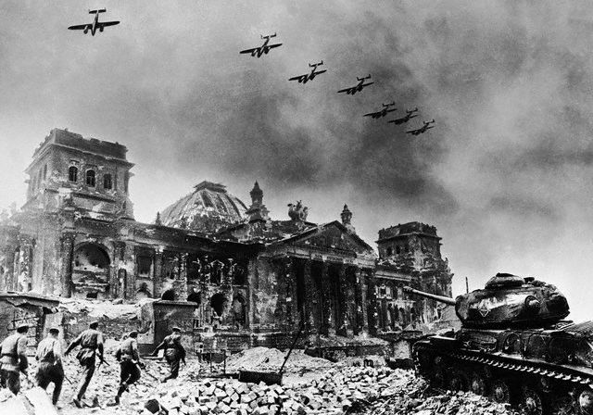
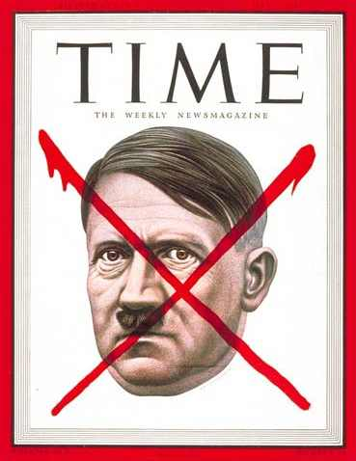
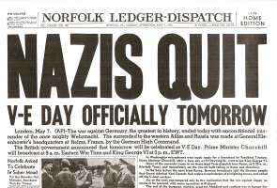
End of European Theatre
Spring, 1945:
Germany surrounded by Soviets to the East and Americans to the West
Close in on capital city of Berlin
April 30th, 1945: Hitler commits suicide
May 7th, 1945: Germany surrenders to Allied Powers

Slide 3
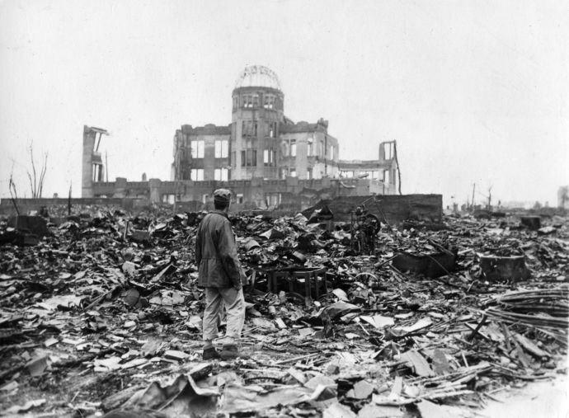
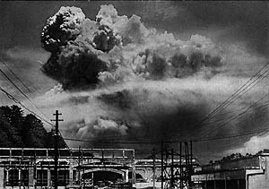
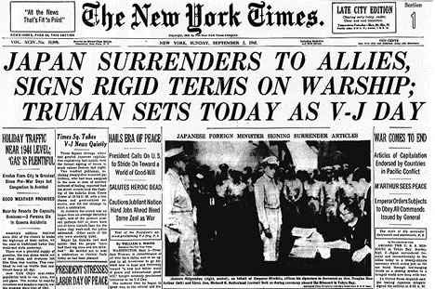
End of Pacific Theatre
Summer 1945:
Allies preparing for an invasion of Japanese mainland.
Decide against invasion to avoid civilian casualties.
August 6th, 1945: Atomic bombing of Hiroshima
August 9th, 1945: Atomic bombing of Nagasaki
Total of 120,000 civilian casualties from the two bombs.
September 2nd, 1945: Japan surrenders

Slide 4
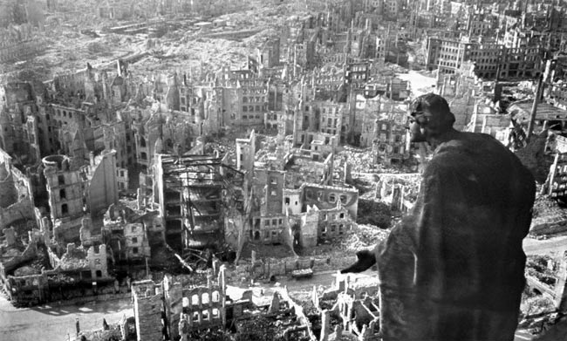
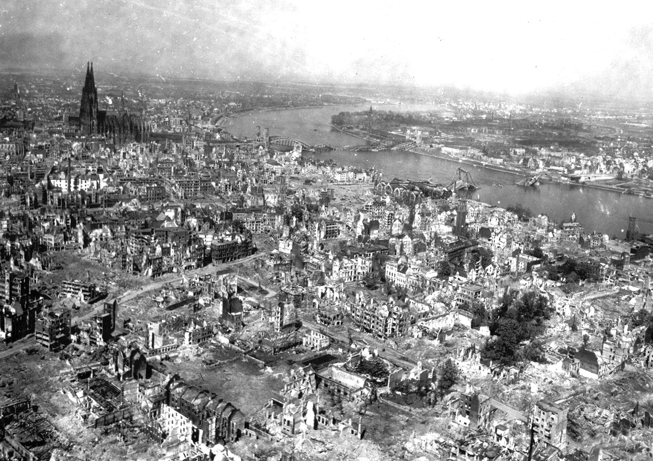
Marshall Plan
1948 - 1952
American initiative to aid Europe in the aftermath of WWII.
U.S. gave $13 billion
Goal was to rebuild war-devastated regions and prevent the spread of Communism.
No Marshall Plan after WWI nor in the Middle East

Slide 5
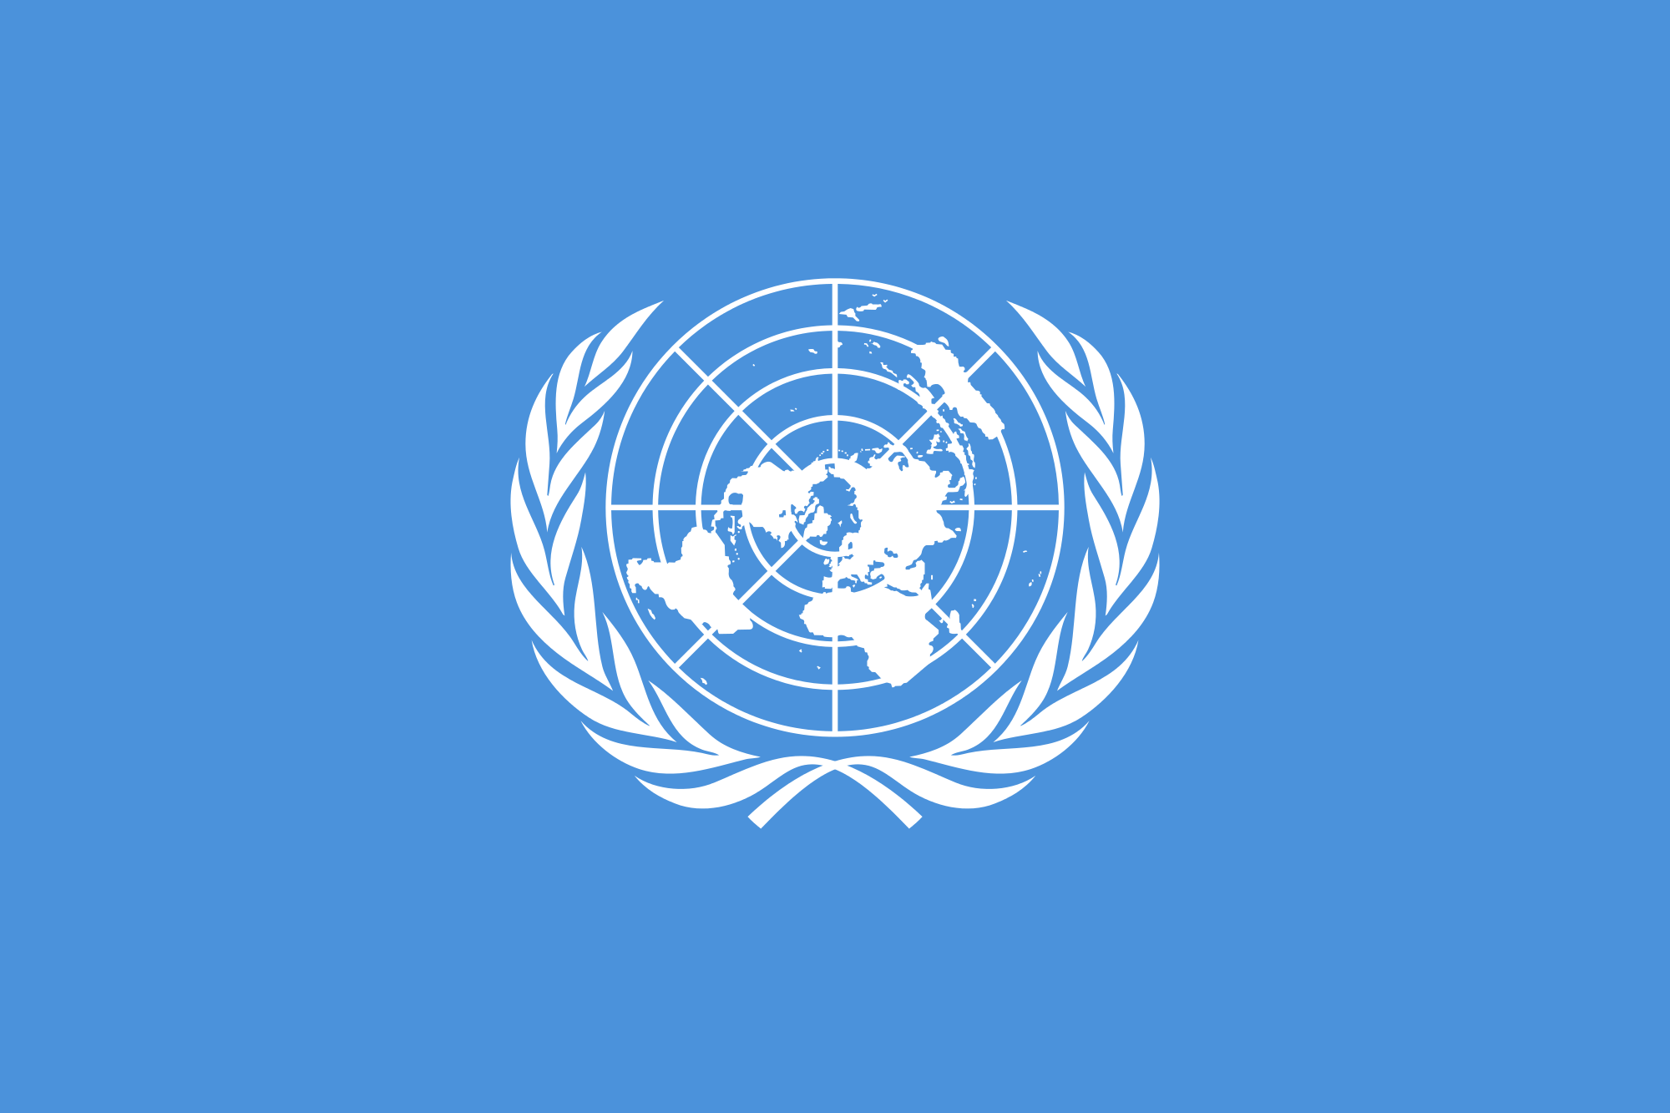
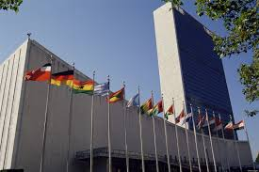
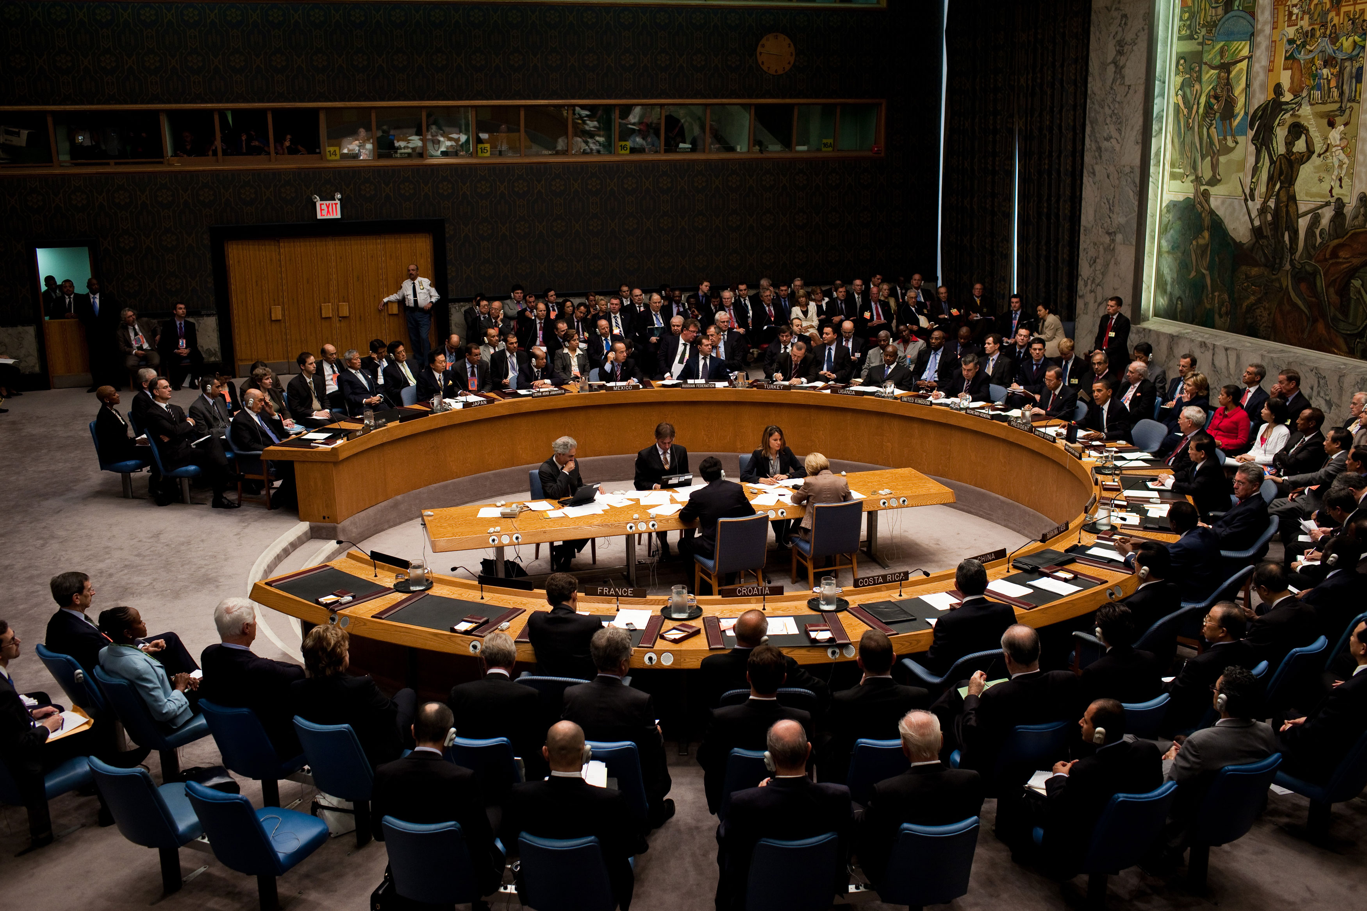
United Nations
League of Nations (created after WWI) failed in its mission to maintain world peace.
New world order is needed
UN formally established in 1945
Today the UN acts as an intergovernmental organization that promotes international co-operation.
139 participating countries

Slide 6
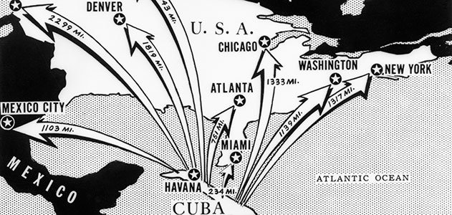
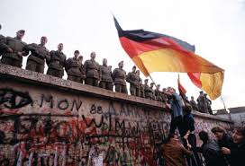
Cold War
Created out of the aftermath of WWII.
Scramble for war torn regions of Europe.
Competition between communist countries and the western world turns into a 44 year period of political and military tension.
Termed “cold” because no large-scale fighting took place

