Slide 1
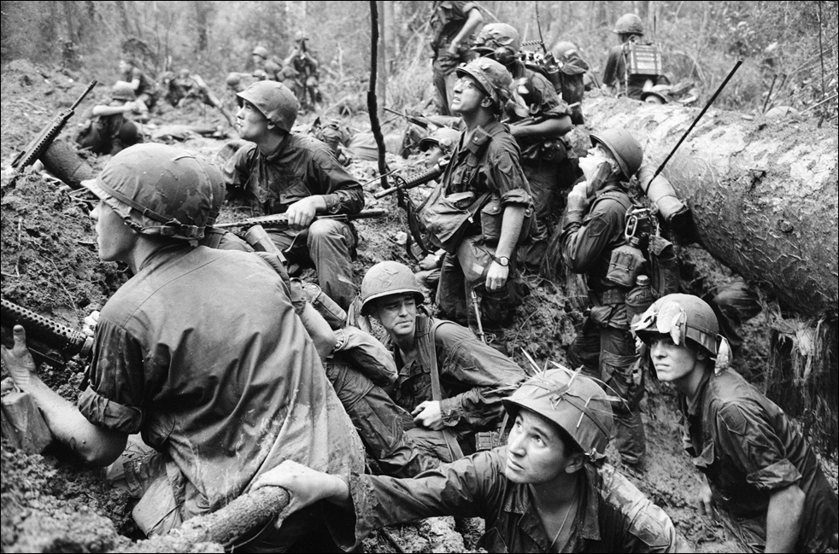
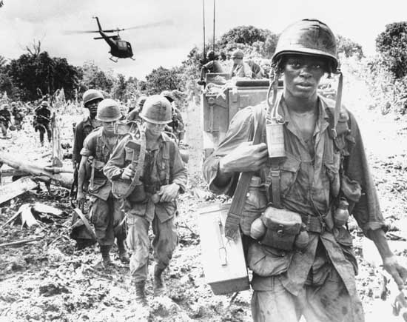
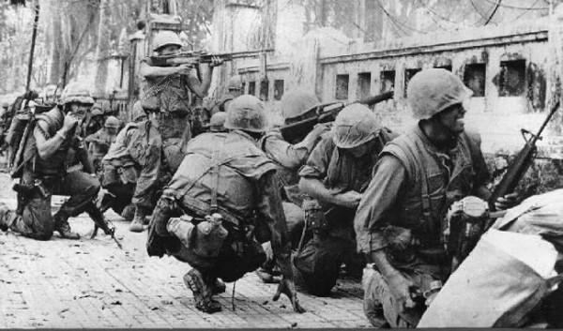
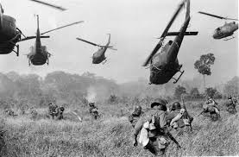
The Vietnam War 1955-1975

Slide 2
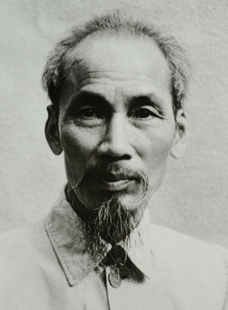
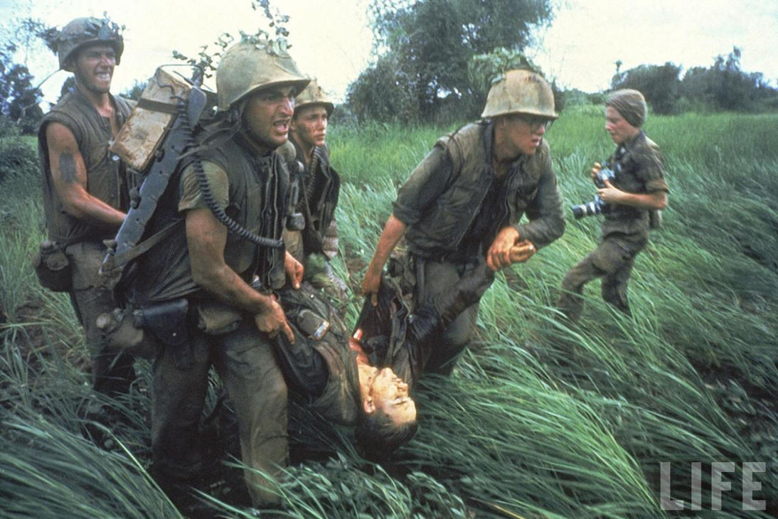
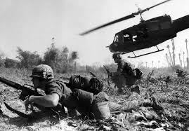
Introduction to Vietnam War
Situation in Vietnam is very similar to that in Korea
North Vietnam = Communist
South Vietnam = Democratic
French colonizers opposed by Ho Chi Minh and communist Vietcong
Throughout the early 1960s, the U.S. sent advisors to South Vietnam.
Military personnel soon sent as well

Slide 3
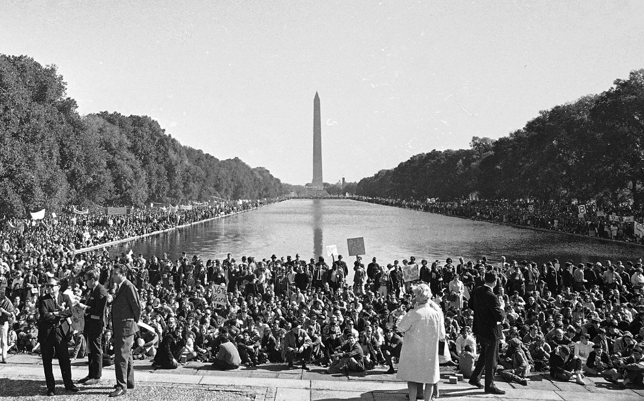
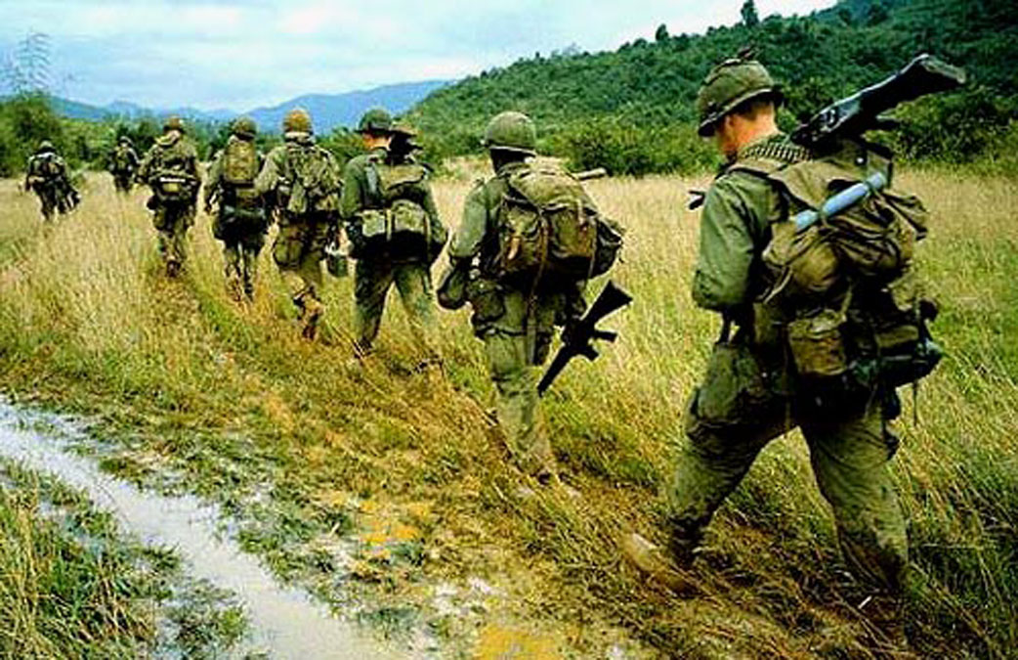
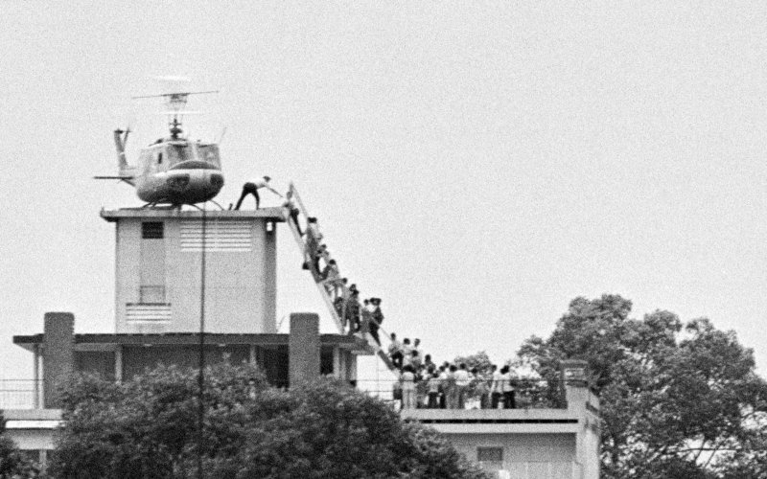
Vietnam War Timeline
1964: Gulf of Tonkin Incident and Resolution
1965: US Troop Levels top 200,000
1967: MLK Jr. speaks out against war
1968: Tet Offensive / My Lai Massacre
1969: Massive anti-war demonstration in D.C.
1973: Cease-fire signed in Paris
1975: Last Americans leave Vietnam as Saigon falls

Slide 4
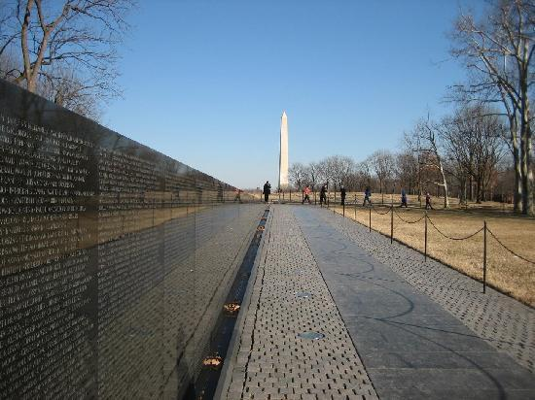
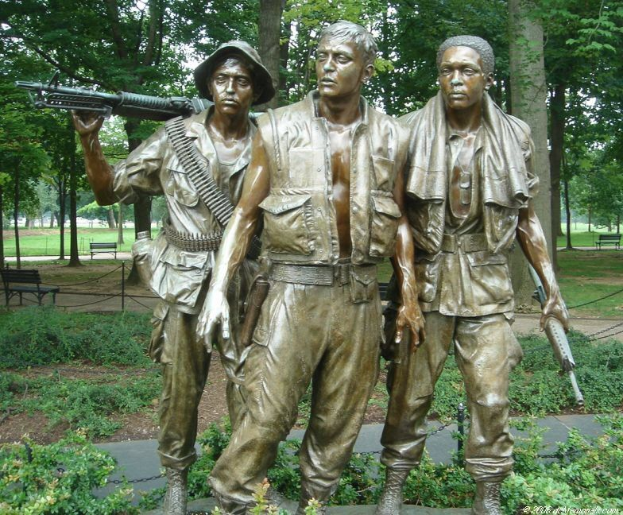
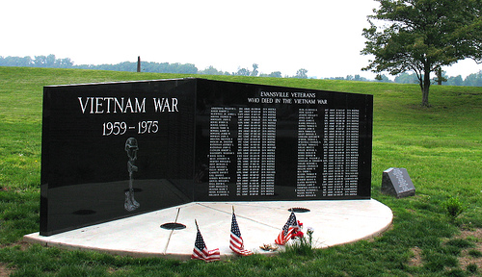
Lasting Impact
58,220 U.S. military casualties
Many veterans suffer from PTSD and cancer
Set the precedent for anti-war movements
Today, Vietnam is a communist country

