Slide 1
European Imperialism in Africa

Slide 2
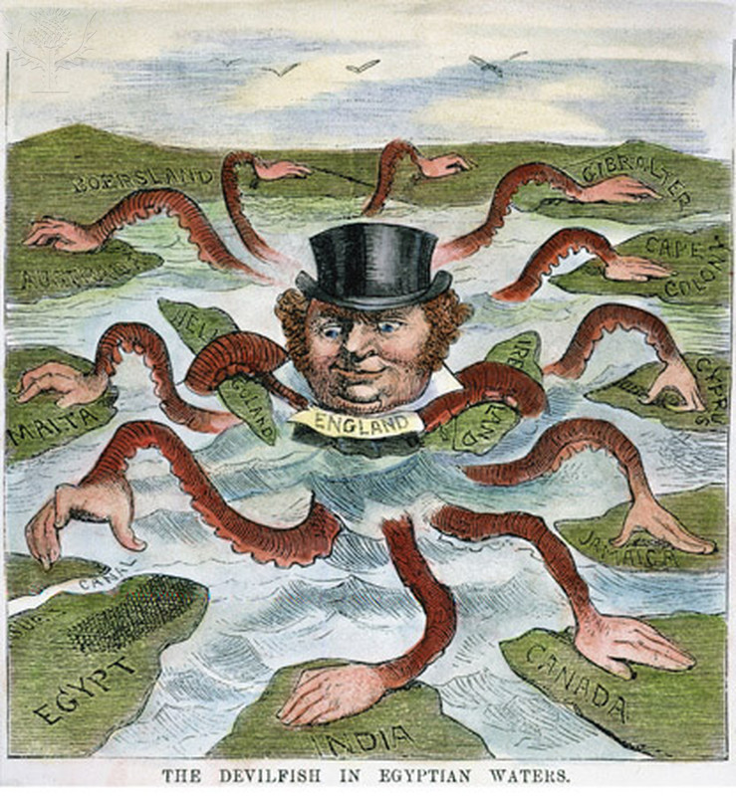
Imperialism
Definition: A policy of extending a country’s power and influence through diplomacy or military force.

Slide 3
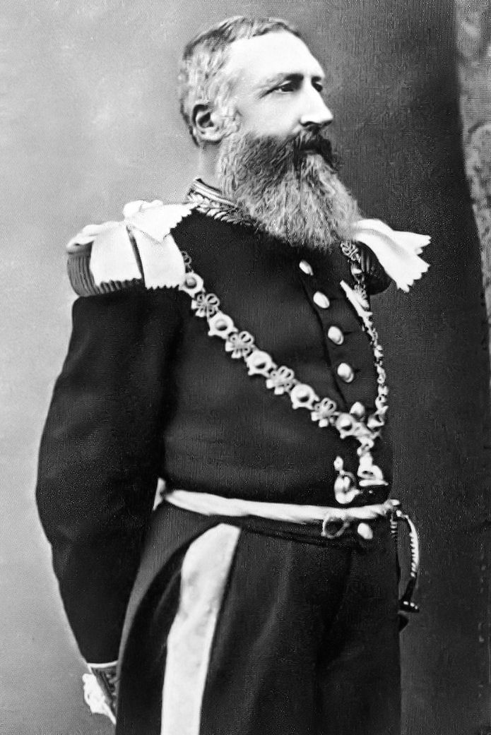
How did it begin?
New World colonies and settlements were gaining independence.
1870’s: King Leopold of Belgium sent merchants to the Congo to establish trade.
All down hill from there.

Slide 4
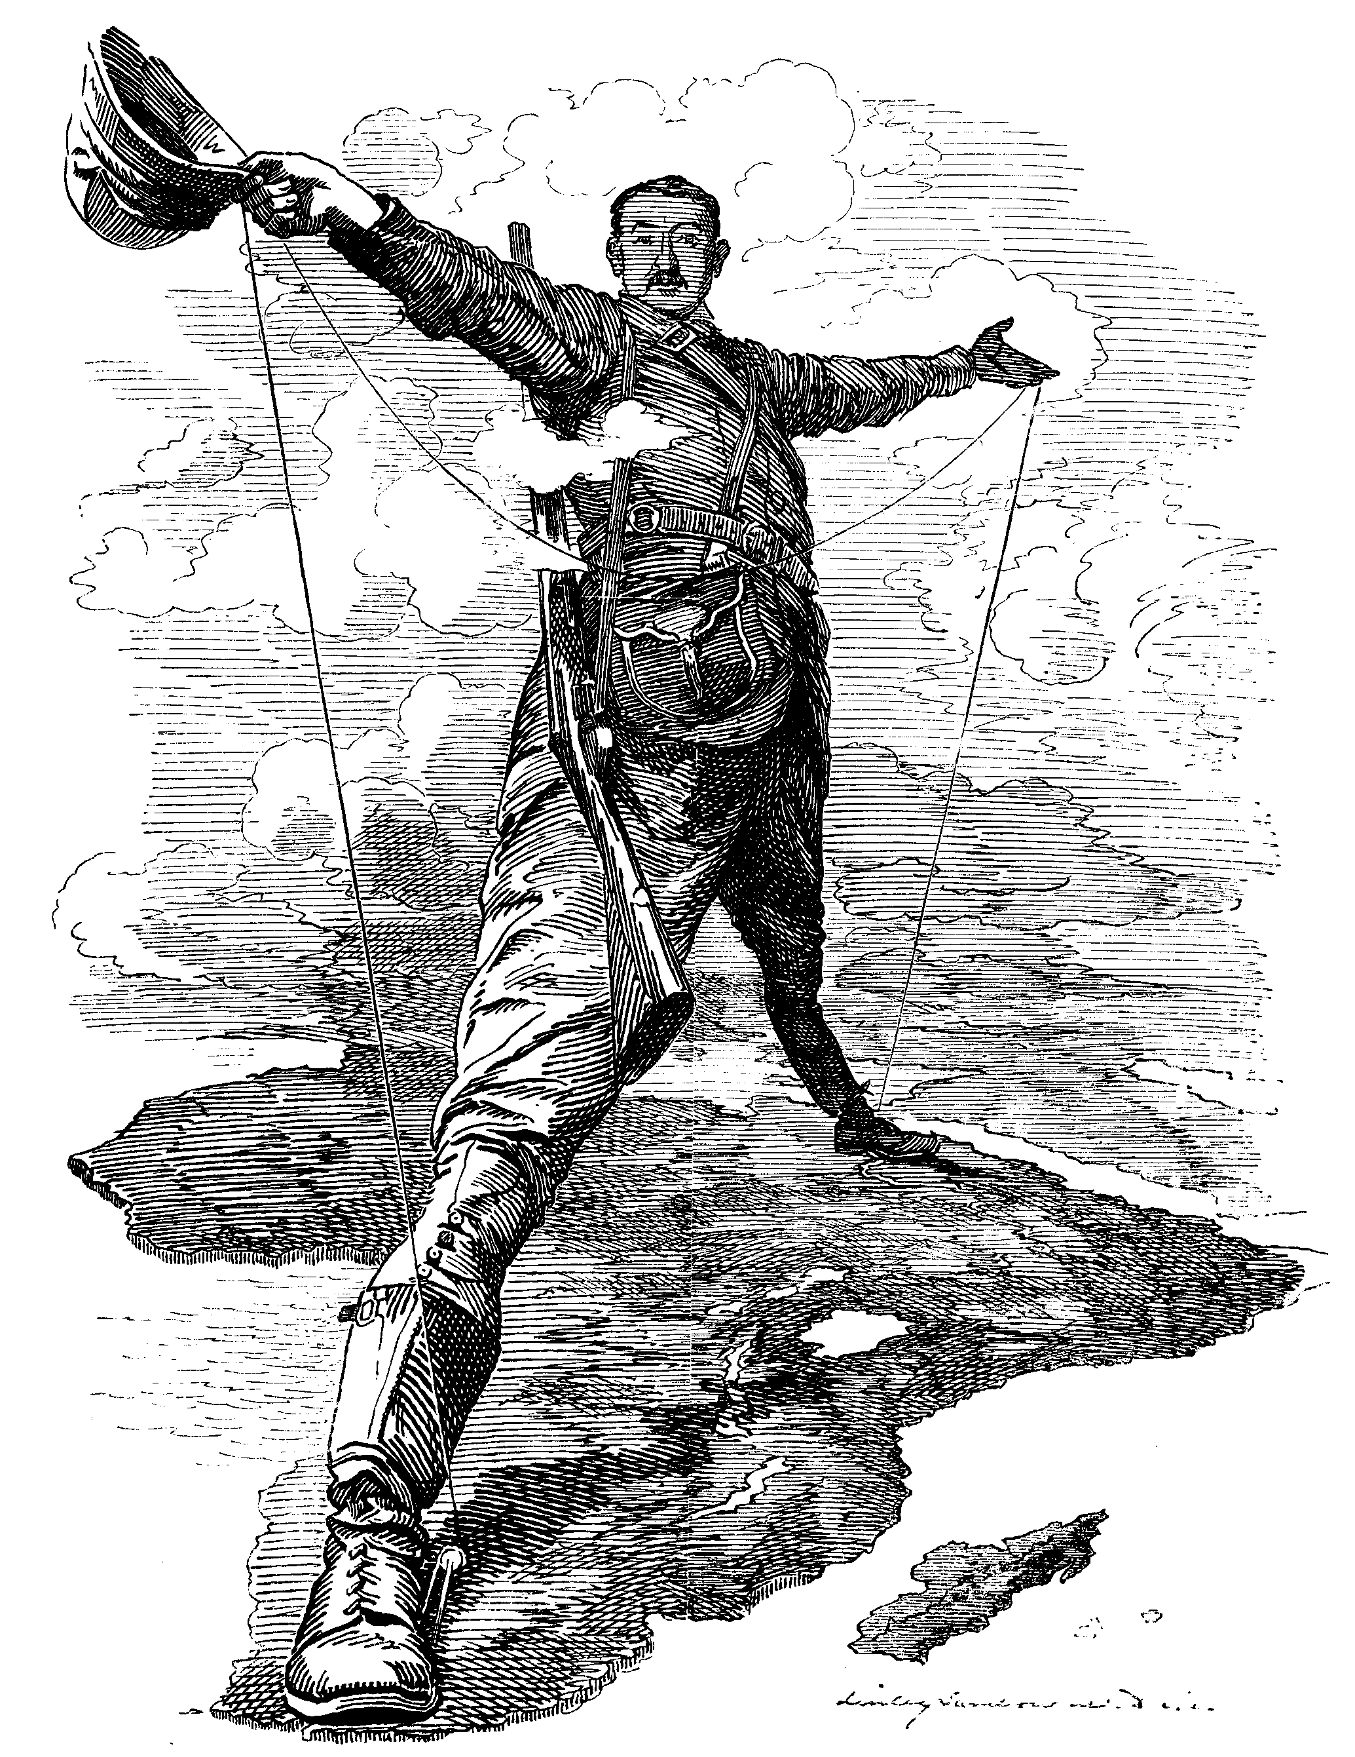
The Scramble for Africa
Africa 1450-1750:
Some colonies along the coast
Traded with the outside world
Began establishing trading posts and colonies

Slide 5
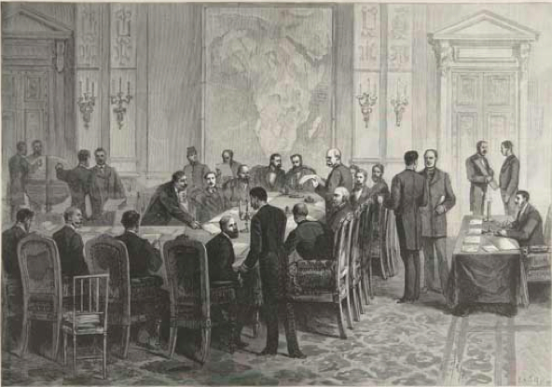
Berlin Conference 1884-1885
European leaders got together and decided what areas of Africa they wanted.
No African leaders present.
Most of Africa colonized by 1900 thanks to Europe’s better technology.

Slide 6
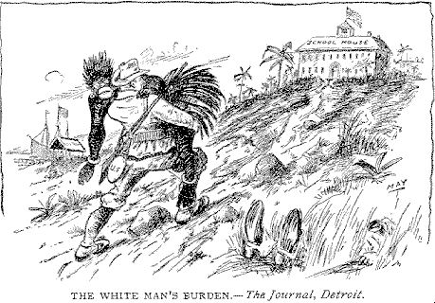
Motives for European Imperialism
White Man’s Burden:
Native people are inferior to Westerners
Natural resources:
Cheap materials
Abundance
Low competition
Huge profits

Slide 7
Where was Africa colonized?

