Slide 1
Great Depression

Slide 2
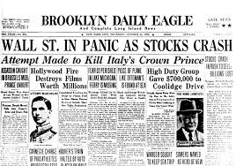
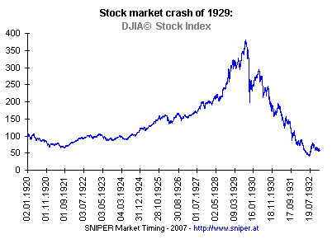
Beginnings
October 1929: Catastrophic collapse of stock-market prices on the NYSE.
Stocks drop to 20% of their original value.
Event becomes known as Black Tuesday.

Slide 3
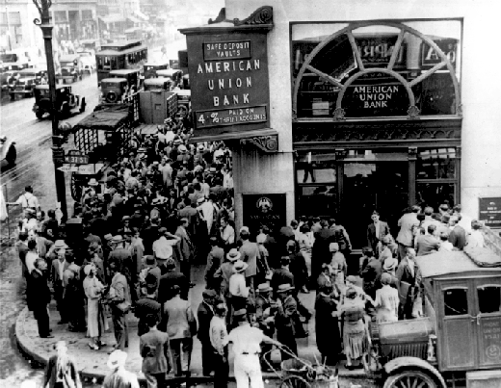
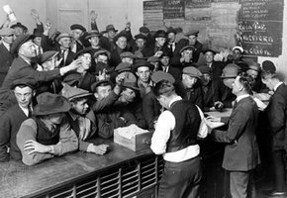
Black Tuesday Aftermath
Stock market crash puts strain on banks.
By 1933 half of all U.S. banks had failed.
Banks panic and begin calling in debts.
Account holders rush to the banks to empty their accounts.
Many are too late.

Slide 4
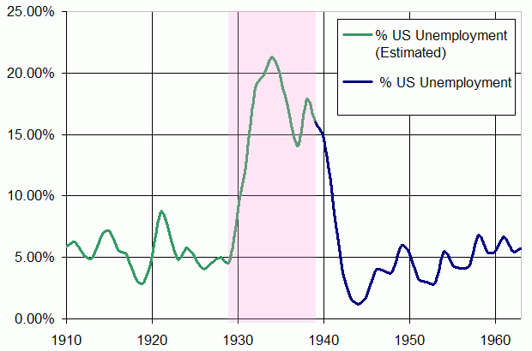
Depression Sets In
Individuals lose confidence in the economy.
Failure of banks + lack of confidence =
Reduced levels of spending
Reduced levels of demand
Reduced levels of production
Result: falling output and rising unemployment

Slide 5
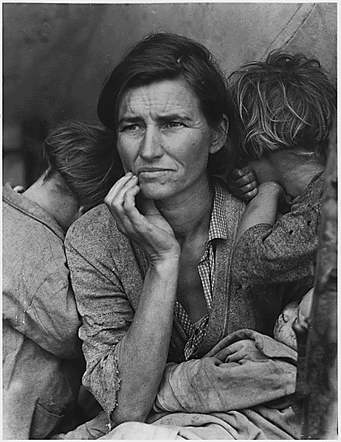
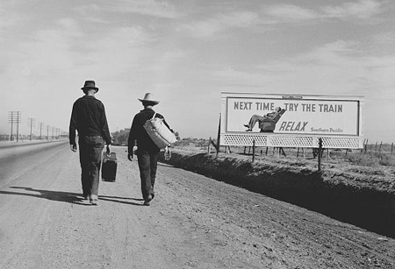
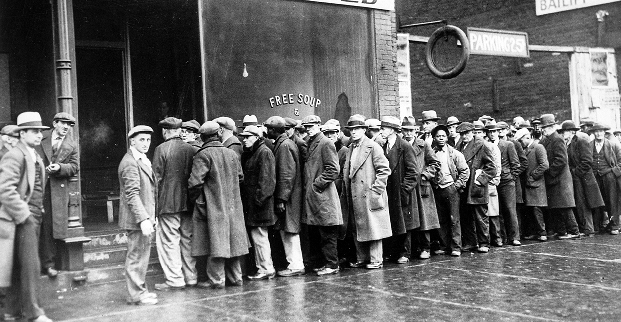
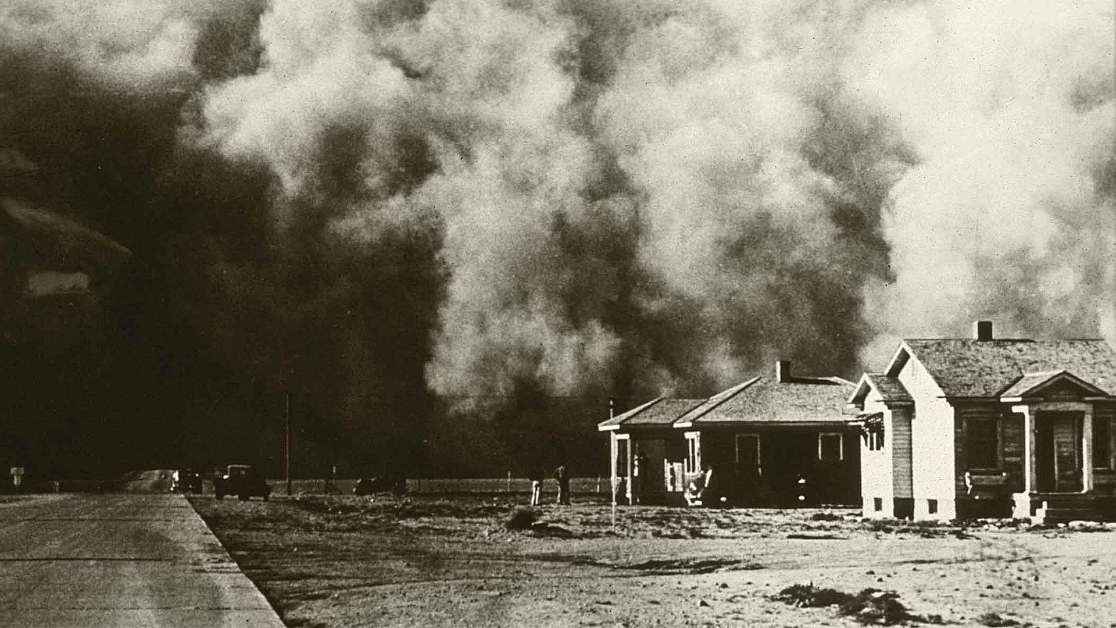

Slide 6
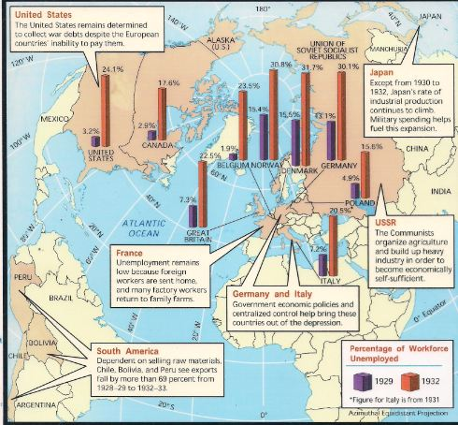
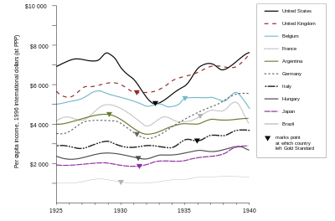
Global Depression
Great depression quickly turned into a worldwide economic slump.
U.S. emerged from WWI as a major creditor and financer of postwar Europe.
Once the U.S. economy crashed, it took most of Europe with it.
Germany and Great Britain suffered most as a result.

