Slide 1
Holocaust

Slide 2
Introduction to the Holocaust
Systematic, bureaucratic, state-sponsored persecution and murder of 6 million Jews by the Nazi regime.
Etymology: Greek origin meaning “sacrifice by fire”
Nazi’s believed that Germans were racially superior, and that Jews were a threat to the German community.
Other targeted groups: Gypsies, the disabled, Slavs, Communists, Socialists, Jehovah’s Witnesses, and homosexuals.

Slide 3
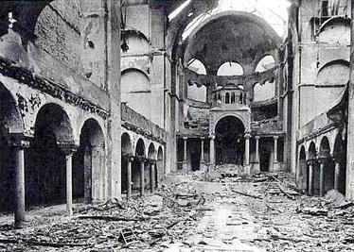
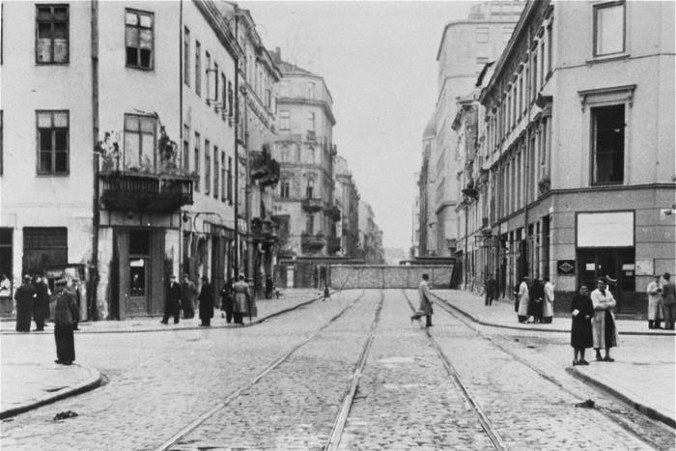
Key Vocab Terms
Pogrom: refers to the total destruction of an entire group of people.
Kristallnacht: wave of violent anti-Jewish attacks.
Ghetto: section in a city in which Jews were relocated to and required to live in.

Slide 4
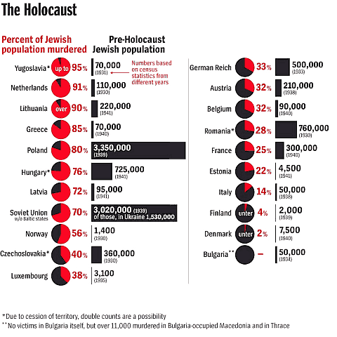
“Final Solution”
Nazi Germany’s plan to exterminate the Jewish population in Nazi-occupied Europe.
Planned to do so using a pogrom.
Claims the lives of 2/3 of Europe’s Jewish population
6 million Jews

Slide 5
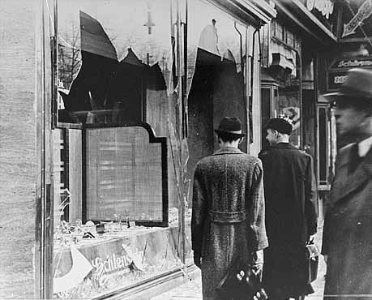
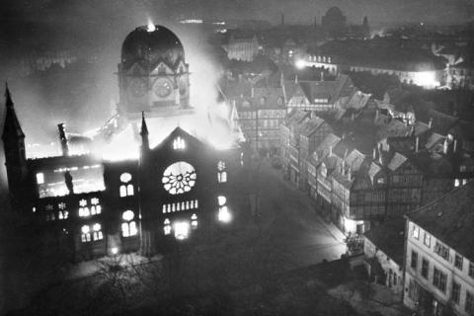
Kristallnacht
“Night of Broken Glass”: November 9th – 10th, 1938
Wave of violent anti-Jewish attacks
Jewish homes, businesses, and synagogues targeted
Perpetrated by the Nazis
German citizens did little to help the Jews, reaffirming to Hitler that he would have little difficulty persecuting the Jews.

Slide 6
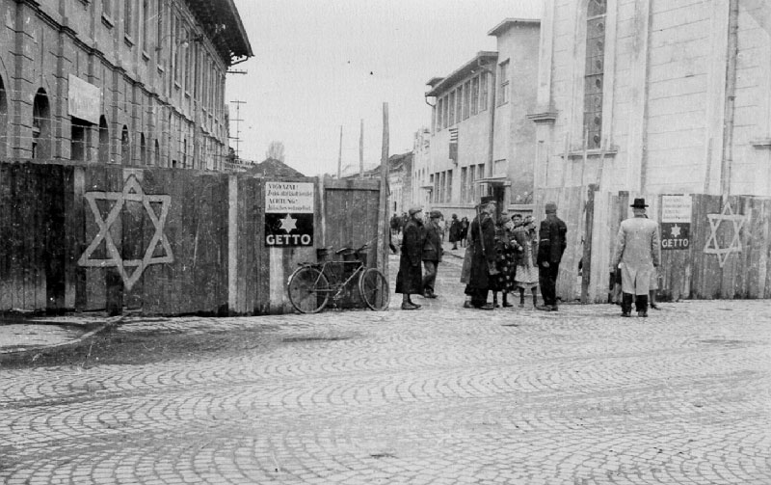
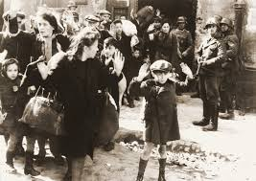
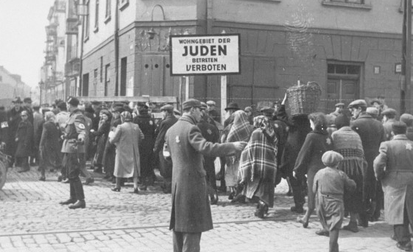
Ghetto
With the support of the German people, the Nazis began to further persecute Jews.
Jews are displaced from their homes and placed in ghettos where they are forced to live under miserable conditions.
Ghettos segregated Jews from non-Jews.
Last stop before concentration camps.

Slide 7
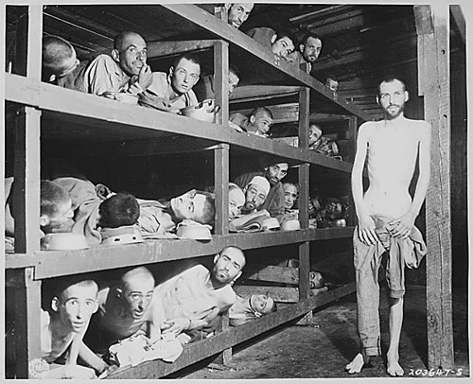
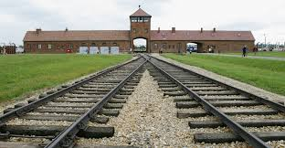
Concentration Camps
First camps opened in 1933 and were used to punish political opponents.
Eventually Jews were shipped to the camps.
Two kinds of concentration camps:
Labor camps
Death camps
Conditions were deplorable and inhumane
Auschwitz, Bergen-Belsen, Buchenwald, Dachau, Treblinka

