Slide 1
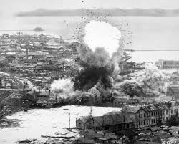
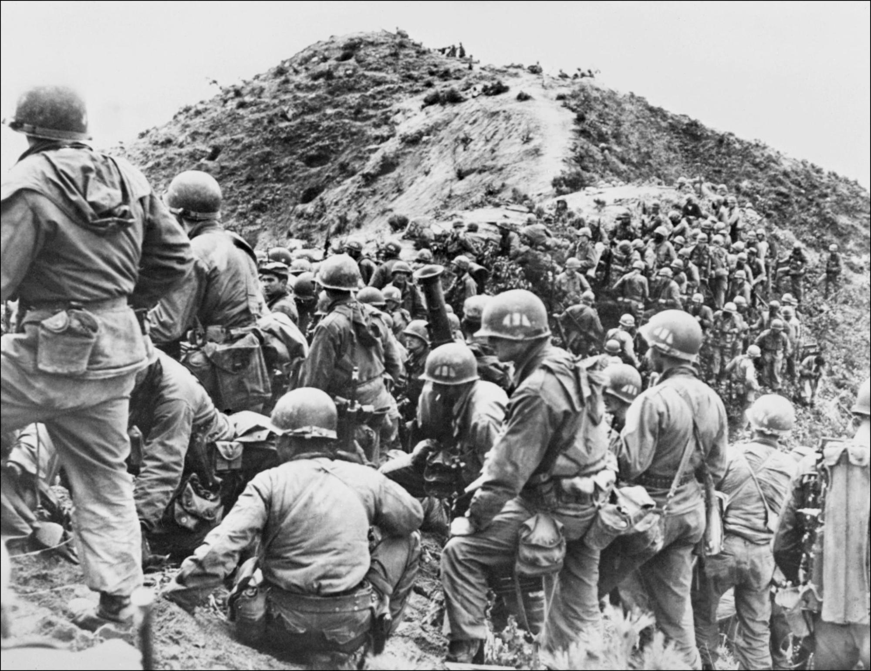
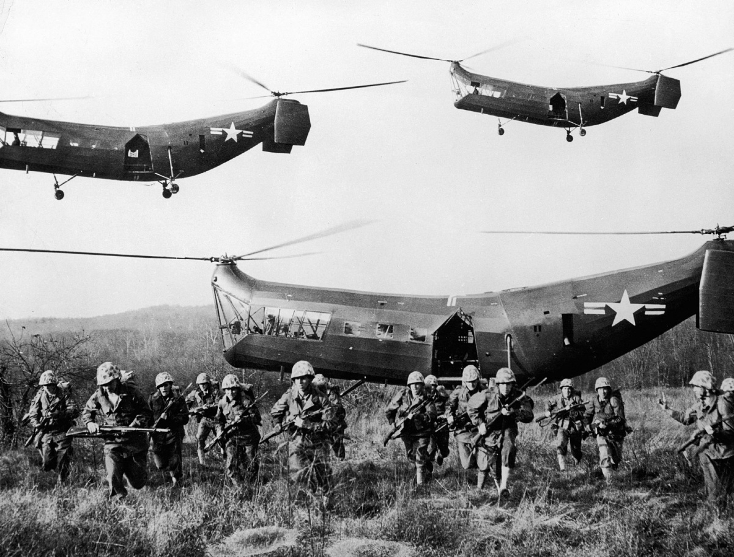
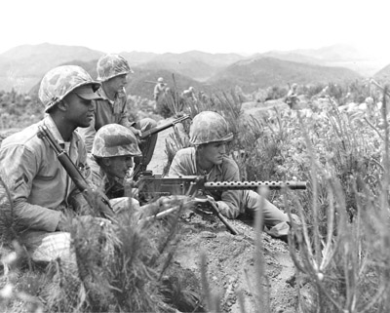
Korean War: 1950 – 1953*

Slide 2
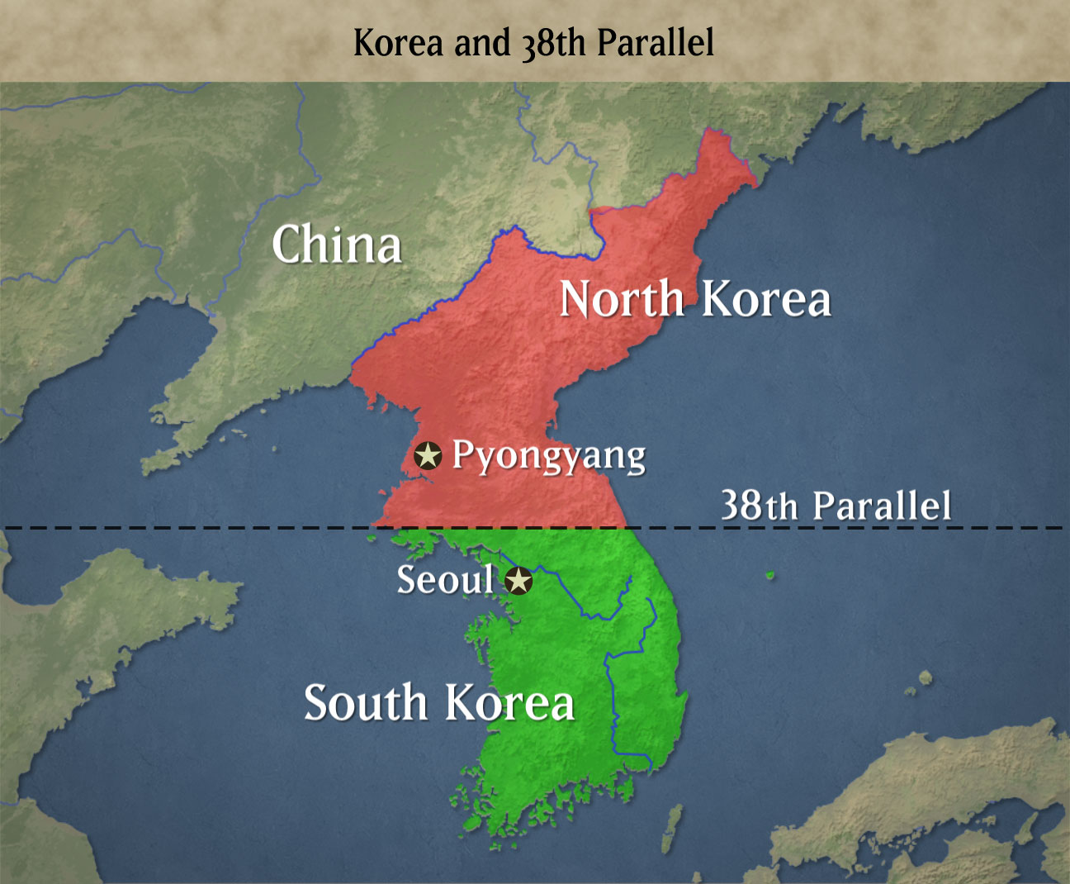
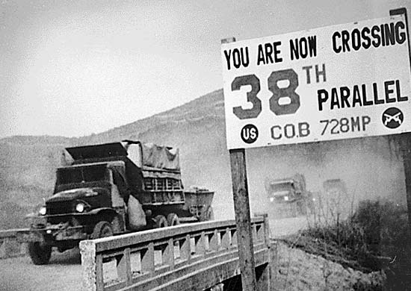
Dividing Korea
Japan controlled Korea prior to WWII
Soviet and US troops defeated the Japanese in Korea during WWII
Soviets and US split Korea at the 38th parallel into two separate zones of occupation
North: Communist
South: Democratic
Soviet/American occupation ended in 1949

Slide 3
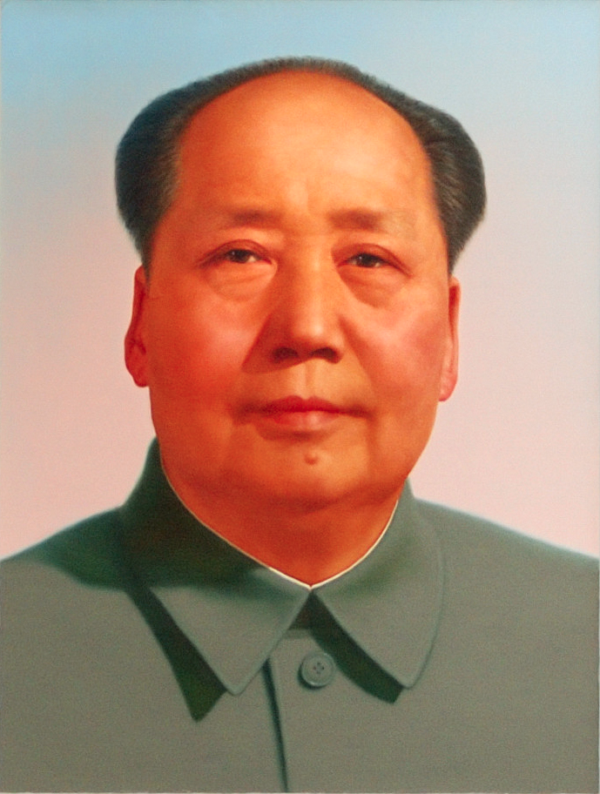
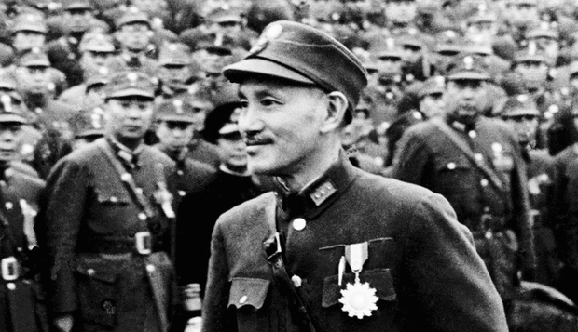
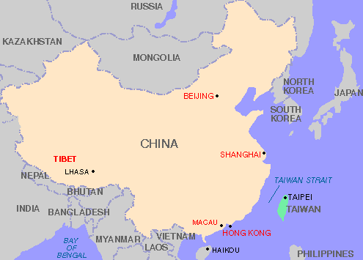
Communist Takeover China
Chinese government was headed by nationalist Chiang Kai-Shek
Communist leader Mao Zedong led a civil war against the government
1949: Communist takeover China
Nationalist were forced to mainland Taiwan

Slide 4
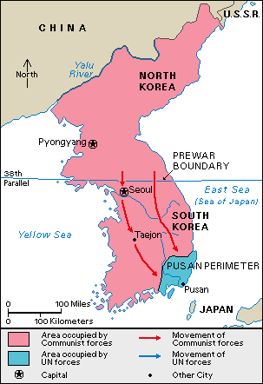
The War Begins
Both sides of the 38th parallel wanted a unified Korea
June 1950: North invaded the South to unite by force
South is completely overrun except for the port city of Pusan
Americans were concerned about the spread of communism.
Truman uses containment and the Truman Doctrine to defend South Korea.

Slide 5
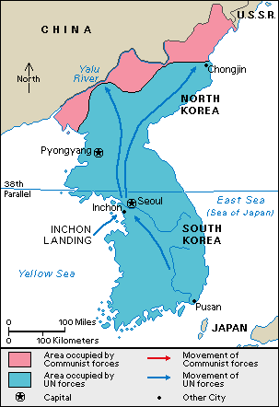
Waging the War
WWII hero, General Douglas MacArthur, leads the fight
MacArthur determined that the North’s rapid advance left their supply lines weak.
MacArthur lands troops at both Inchon and Pusan.
North Korean troops are surrounded and retreat.

Slide 6
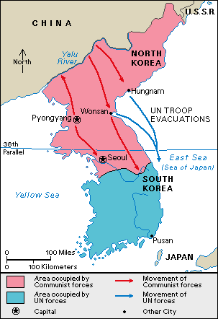
Waging the War Continued
US plans to use troops to unite Korea under the South’s control
Chinese communists did not want a pro-US neighbor
Chinese warn US not to advance any further
November 1950: MacArthur announces his “Home by Christmas” offensive
Chinese respond by sending troops

Slide 7
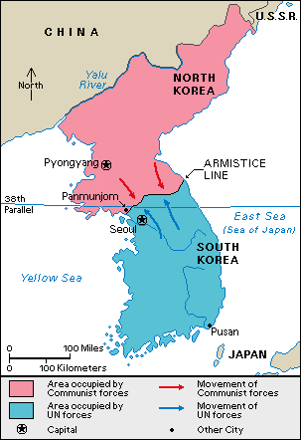
Stalemate and End
Chinese aid the North and push the US back to the 38th parallel
Stalemate at the line develops
MacArthur and Truman disagree about what strategy to use. MacArthur gets fired
1951-1953: Deadly fighting occurs on frontline
1953: War ends with Korea divided at the 38th parallel

Slide 8
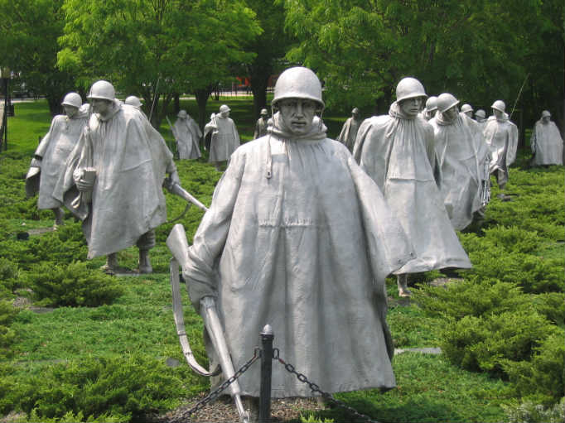
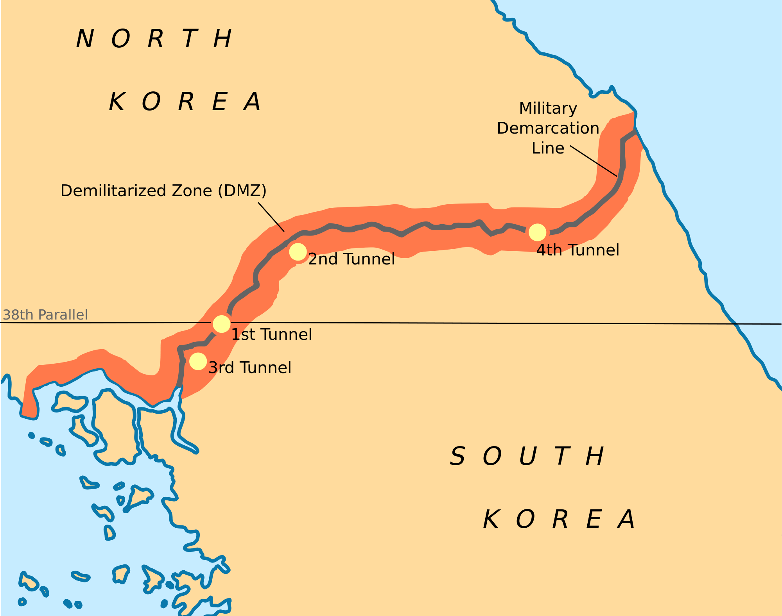
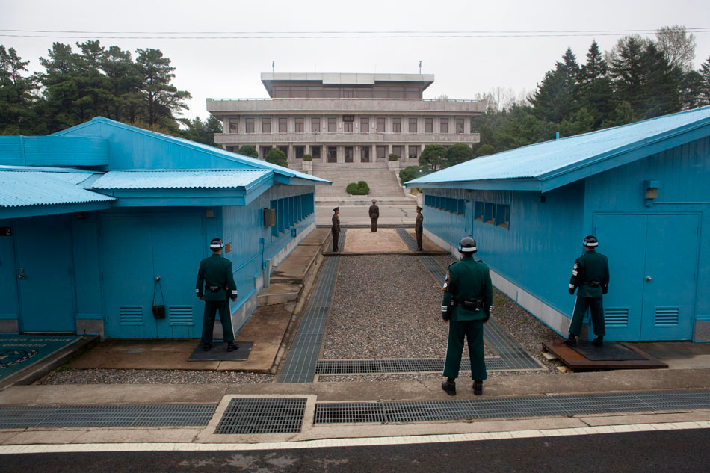
Effects of the Korean War
34,000 American dead; 103,000 wounded
Debate about whether the war was a success or failure
1st war in which integrated units fought together
The war created long lasting tensions between the US, China, and North Korea
Technically we are still at war because no treaty was ever signed. The war ended with a ceasefire

