Slide 1
WWII: European Theatre

Slide 2
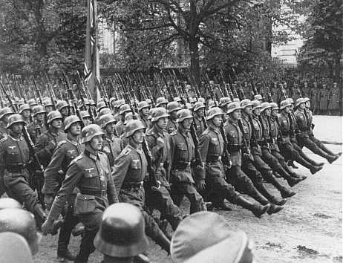
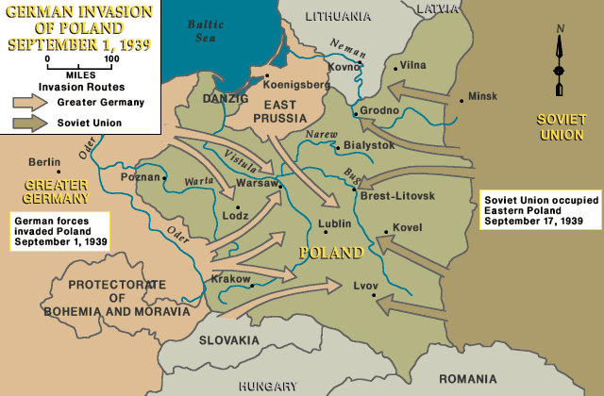
Outbreak of WWII
European theatre of the war begins in 1939 with German invasion of Poland.
Britain and France declared war on Germany in response.
A mutual agreement between the Soviet Union and Germany temporarily kept the two sides from hostilities.

Slide 3
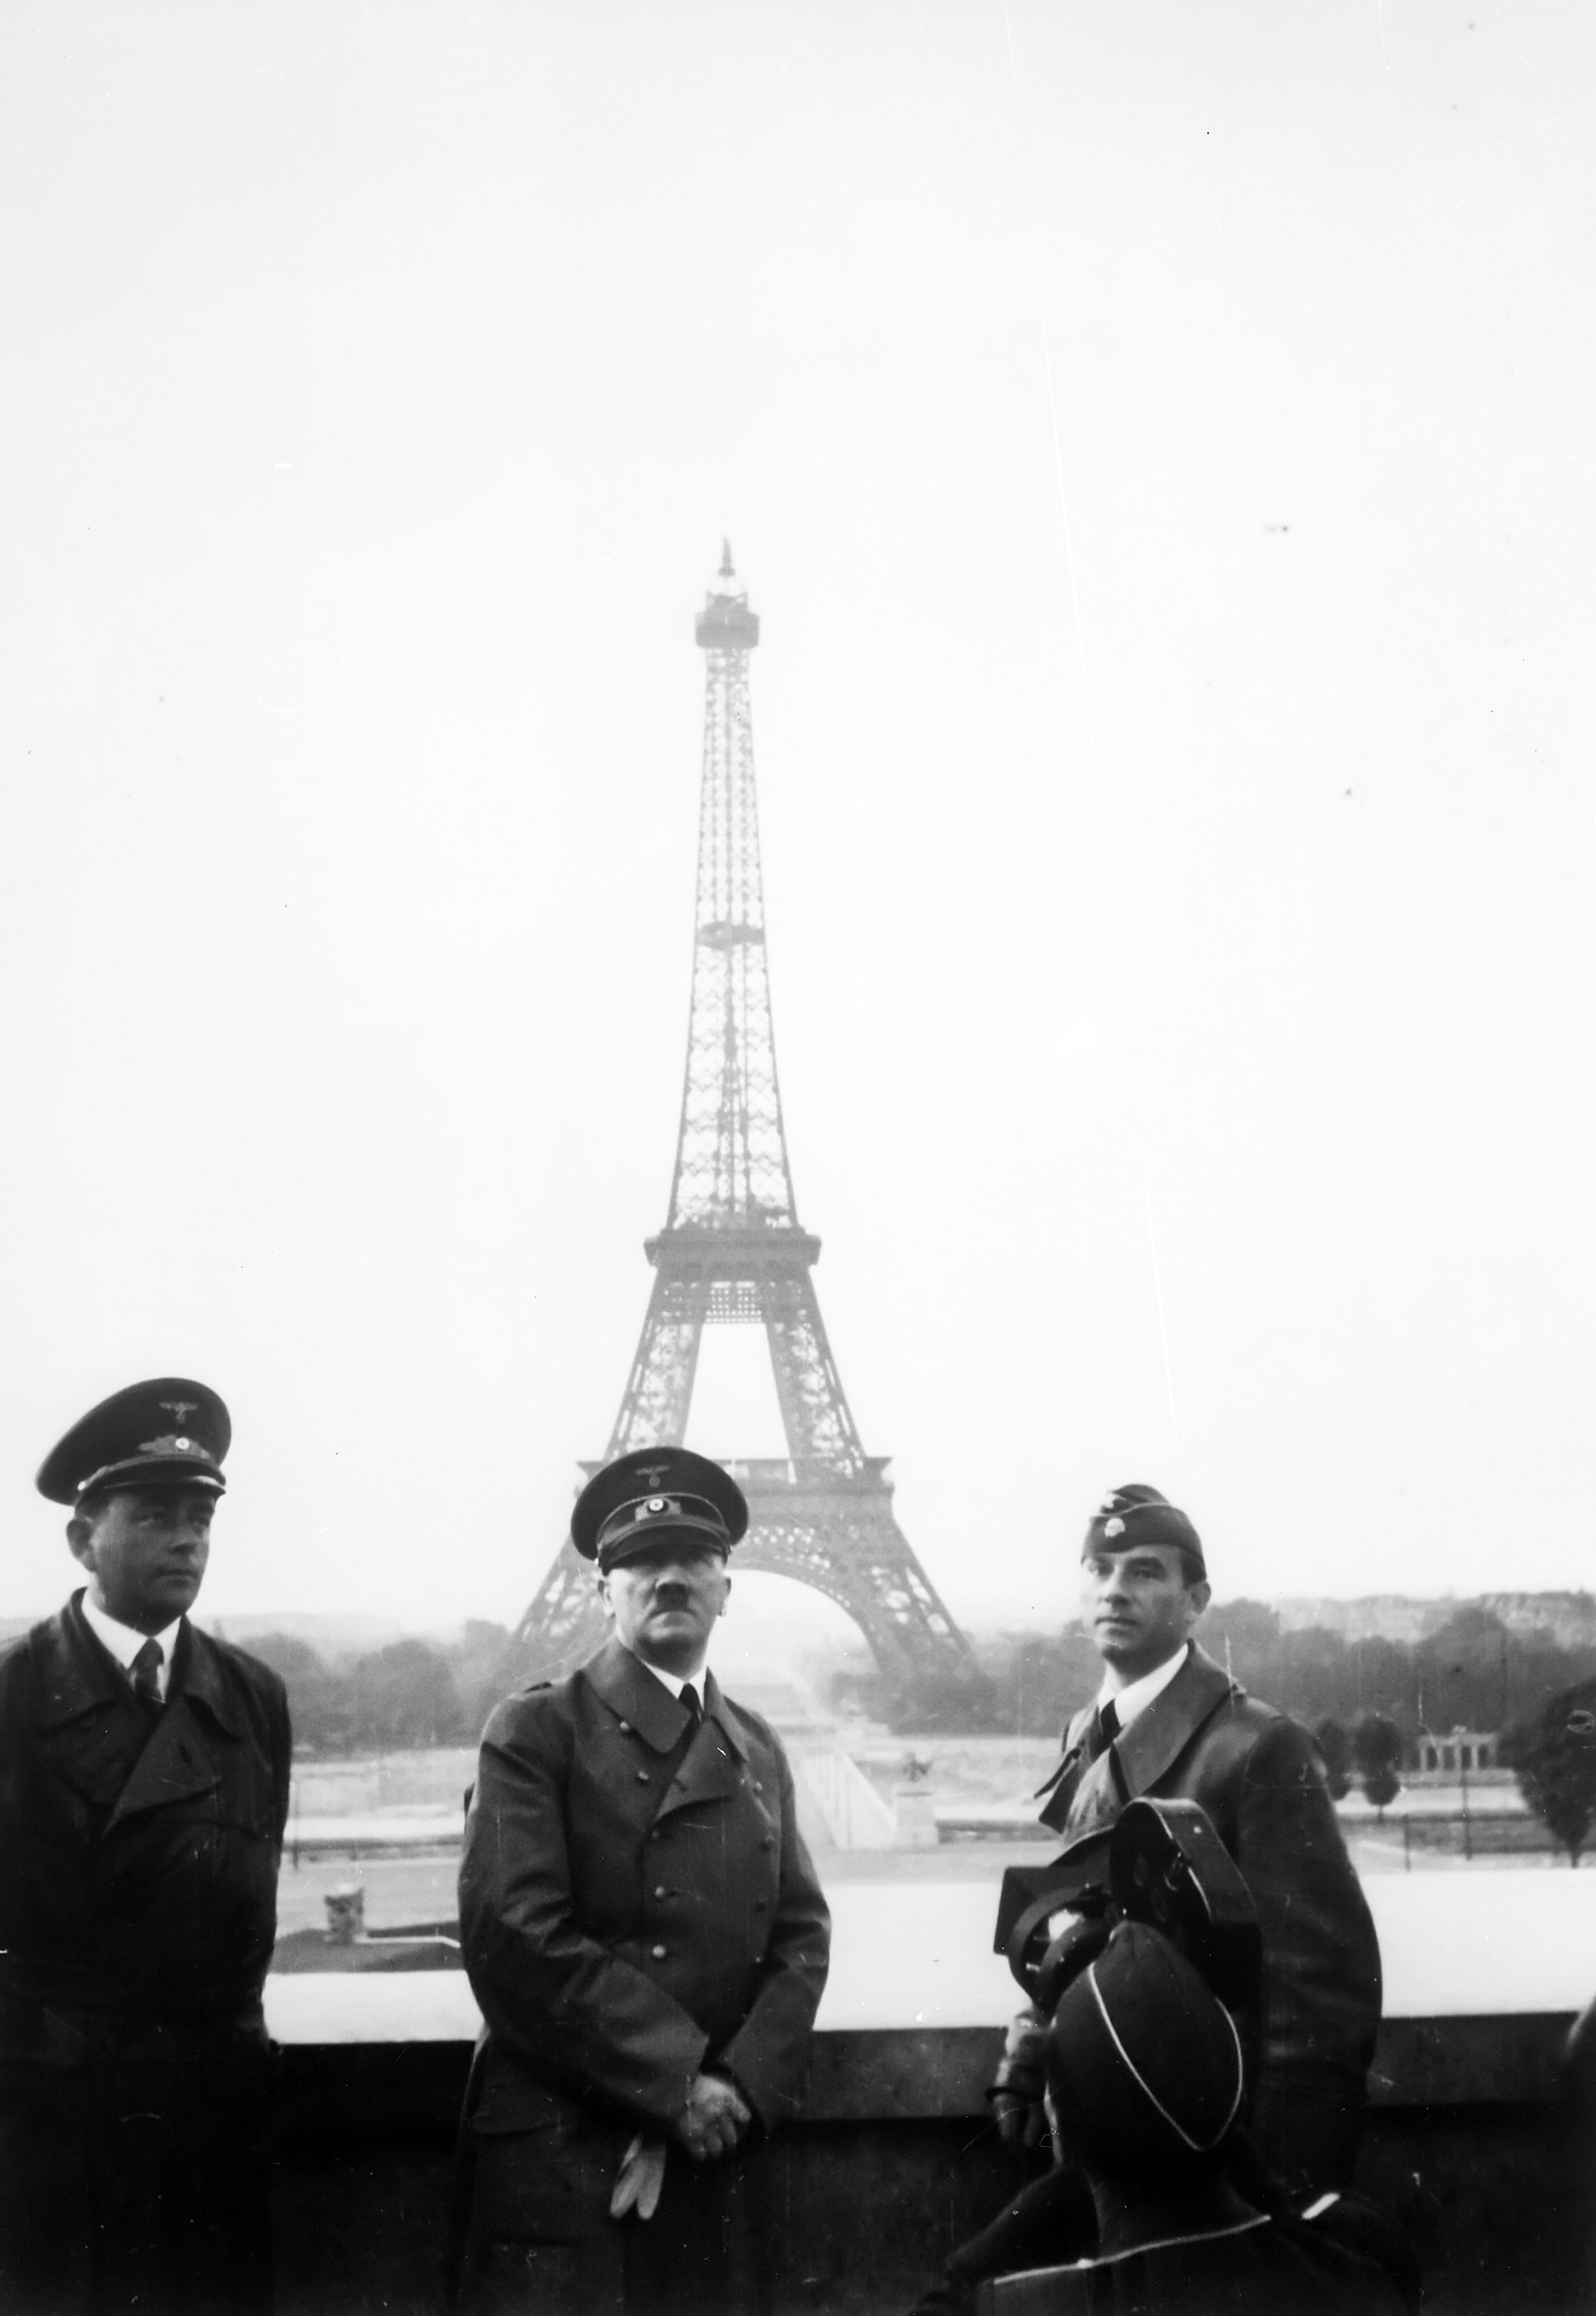
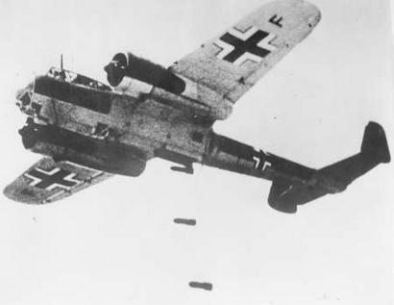
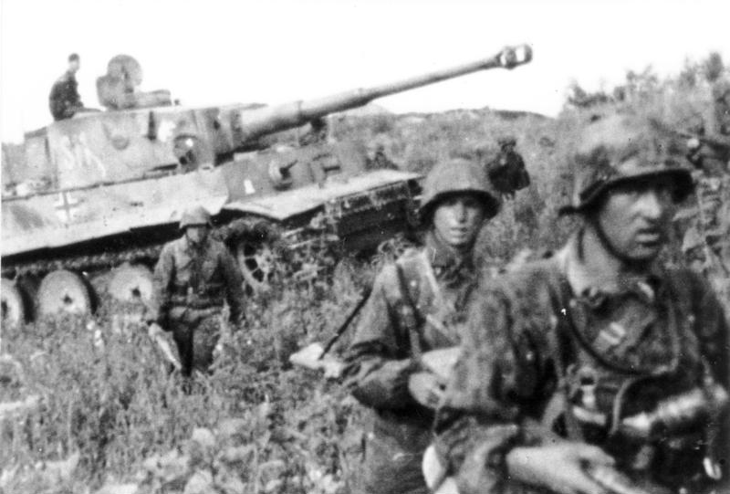
1940
German forces invaded Norway, Denmark, the Netherlands, Belgium, and Luxembourg.
France agreed to an armistice with Germany that allowed German forces to occupy northern France.
Germans use Blitzkrieg to conquer all these territories.
Definition: Bombing by night, taking land by day
German military strategy used against Allied Powers

Slide 4
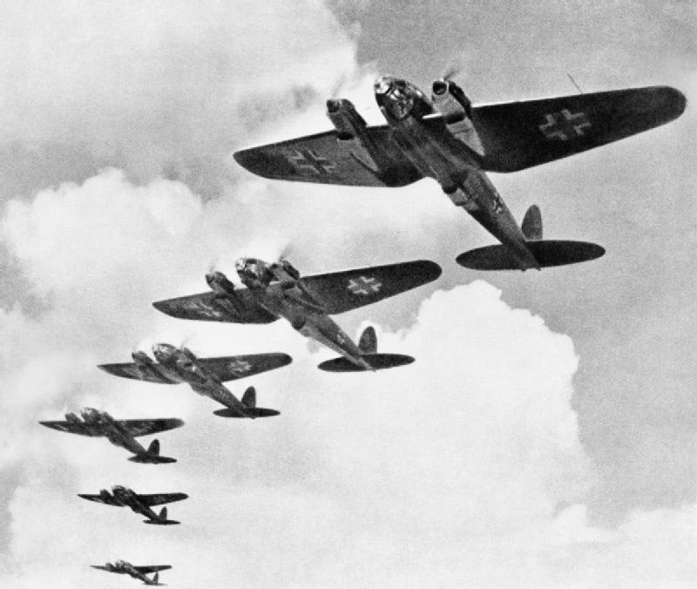
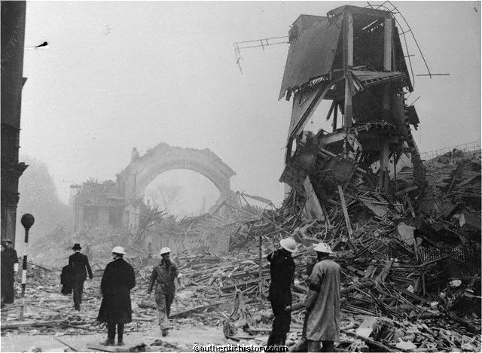
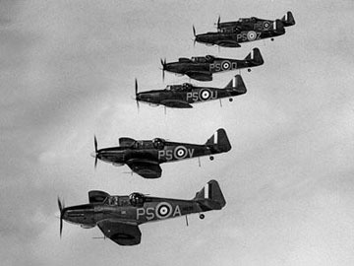
Battle of Britain
Summer – Fall of 1940
Intense air battle between German Luftwaffe and British Royal Air Force.
Sustained bombing campaign by the Nazis
Outcome: Allied victory
Significance: Nazi advance into western Europe stopped

Slide 5
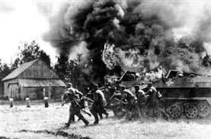
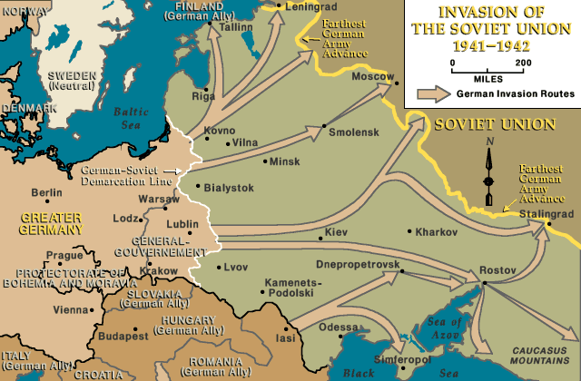
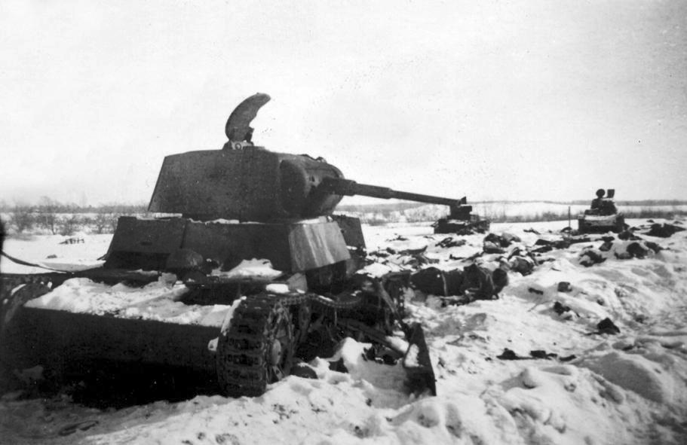
1941
Violating a previously established German-Soviet Pact, German forces invaded the Soviet Union.
Soviet Union switched alliances, and joined Allies.
German forces advanced deep into Soviet territory.
Soviet’s secret weapon: Winter

Slide 6
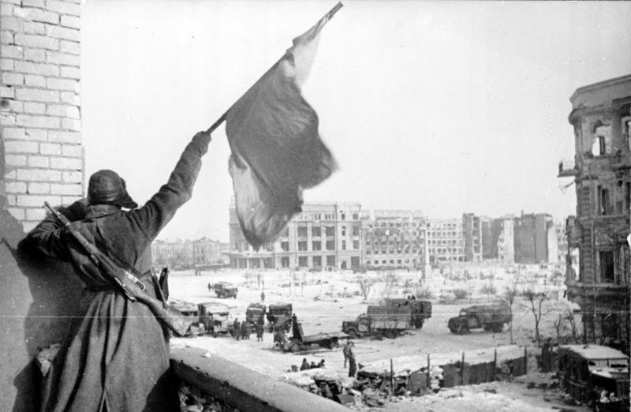
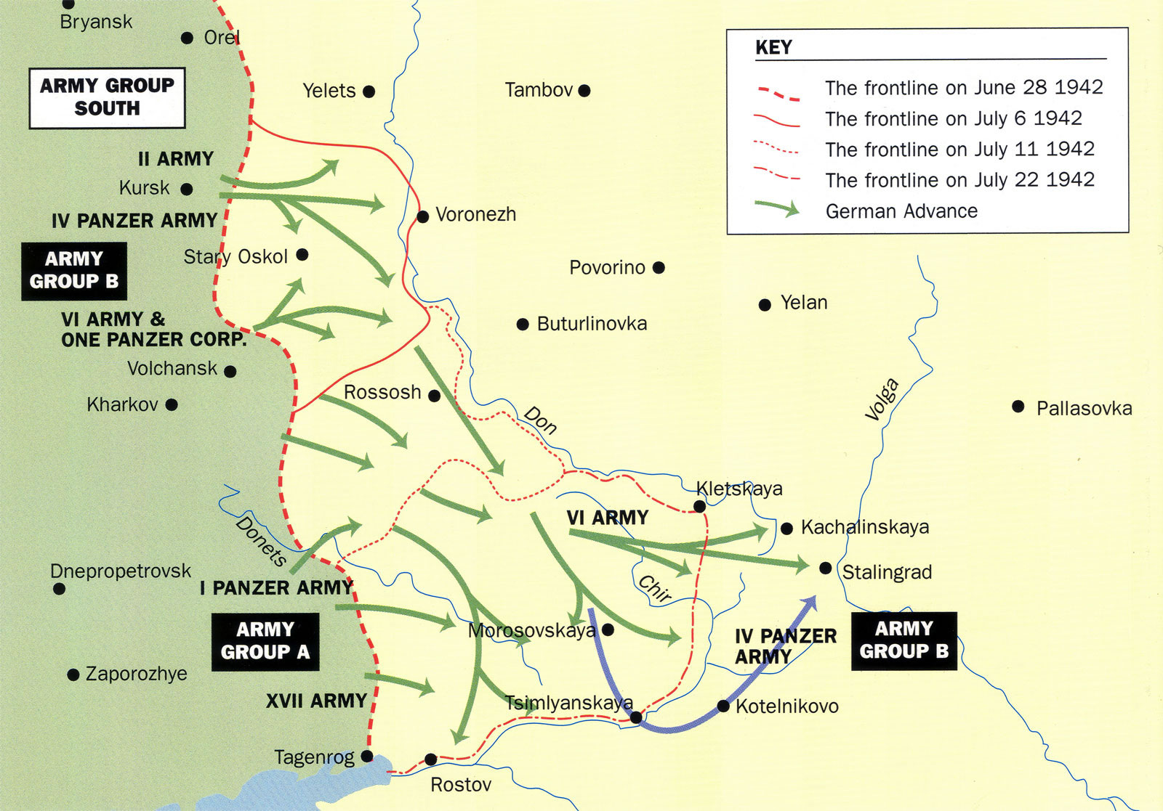
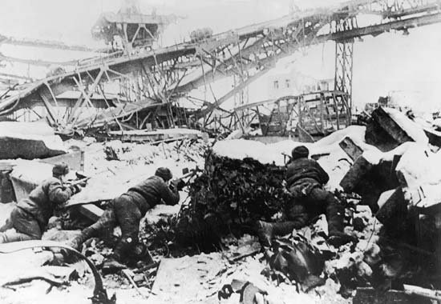
Stalingrad
July 1942 – February 1943
Bloody Soviet defense of the key city of Stalingrad
Nearly 2 million total casualties
Outcome: Allied victory
Significance: First major Nazi defeat and turning point in Europe.

Slide 7
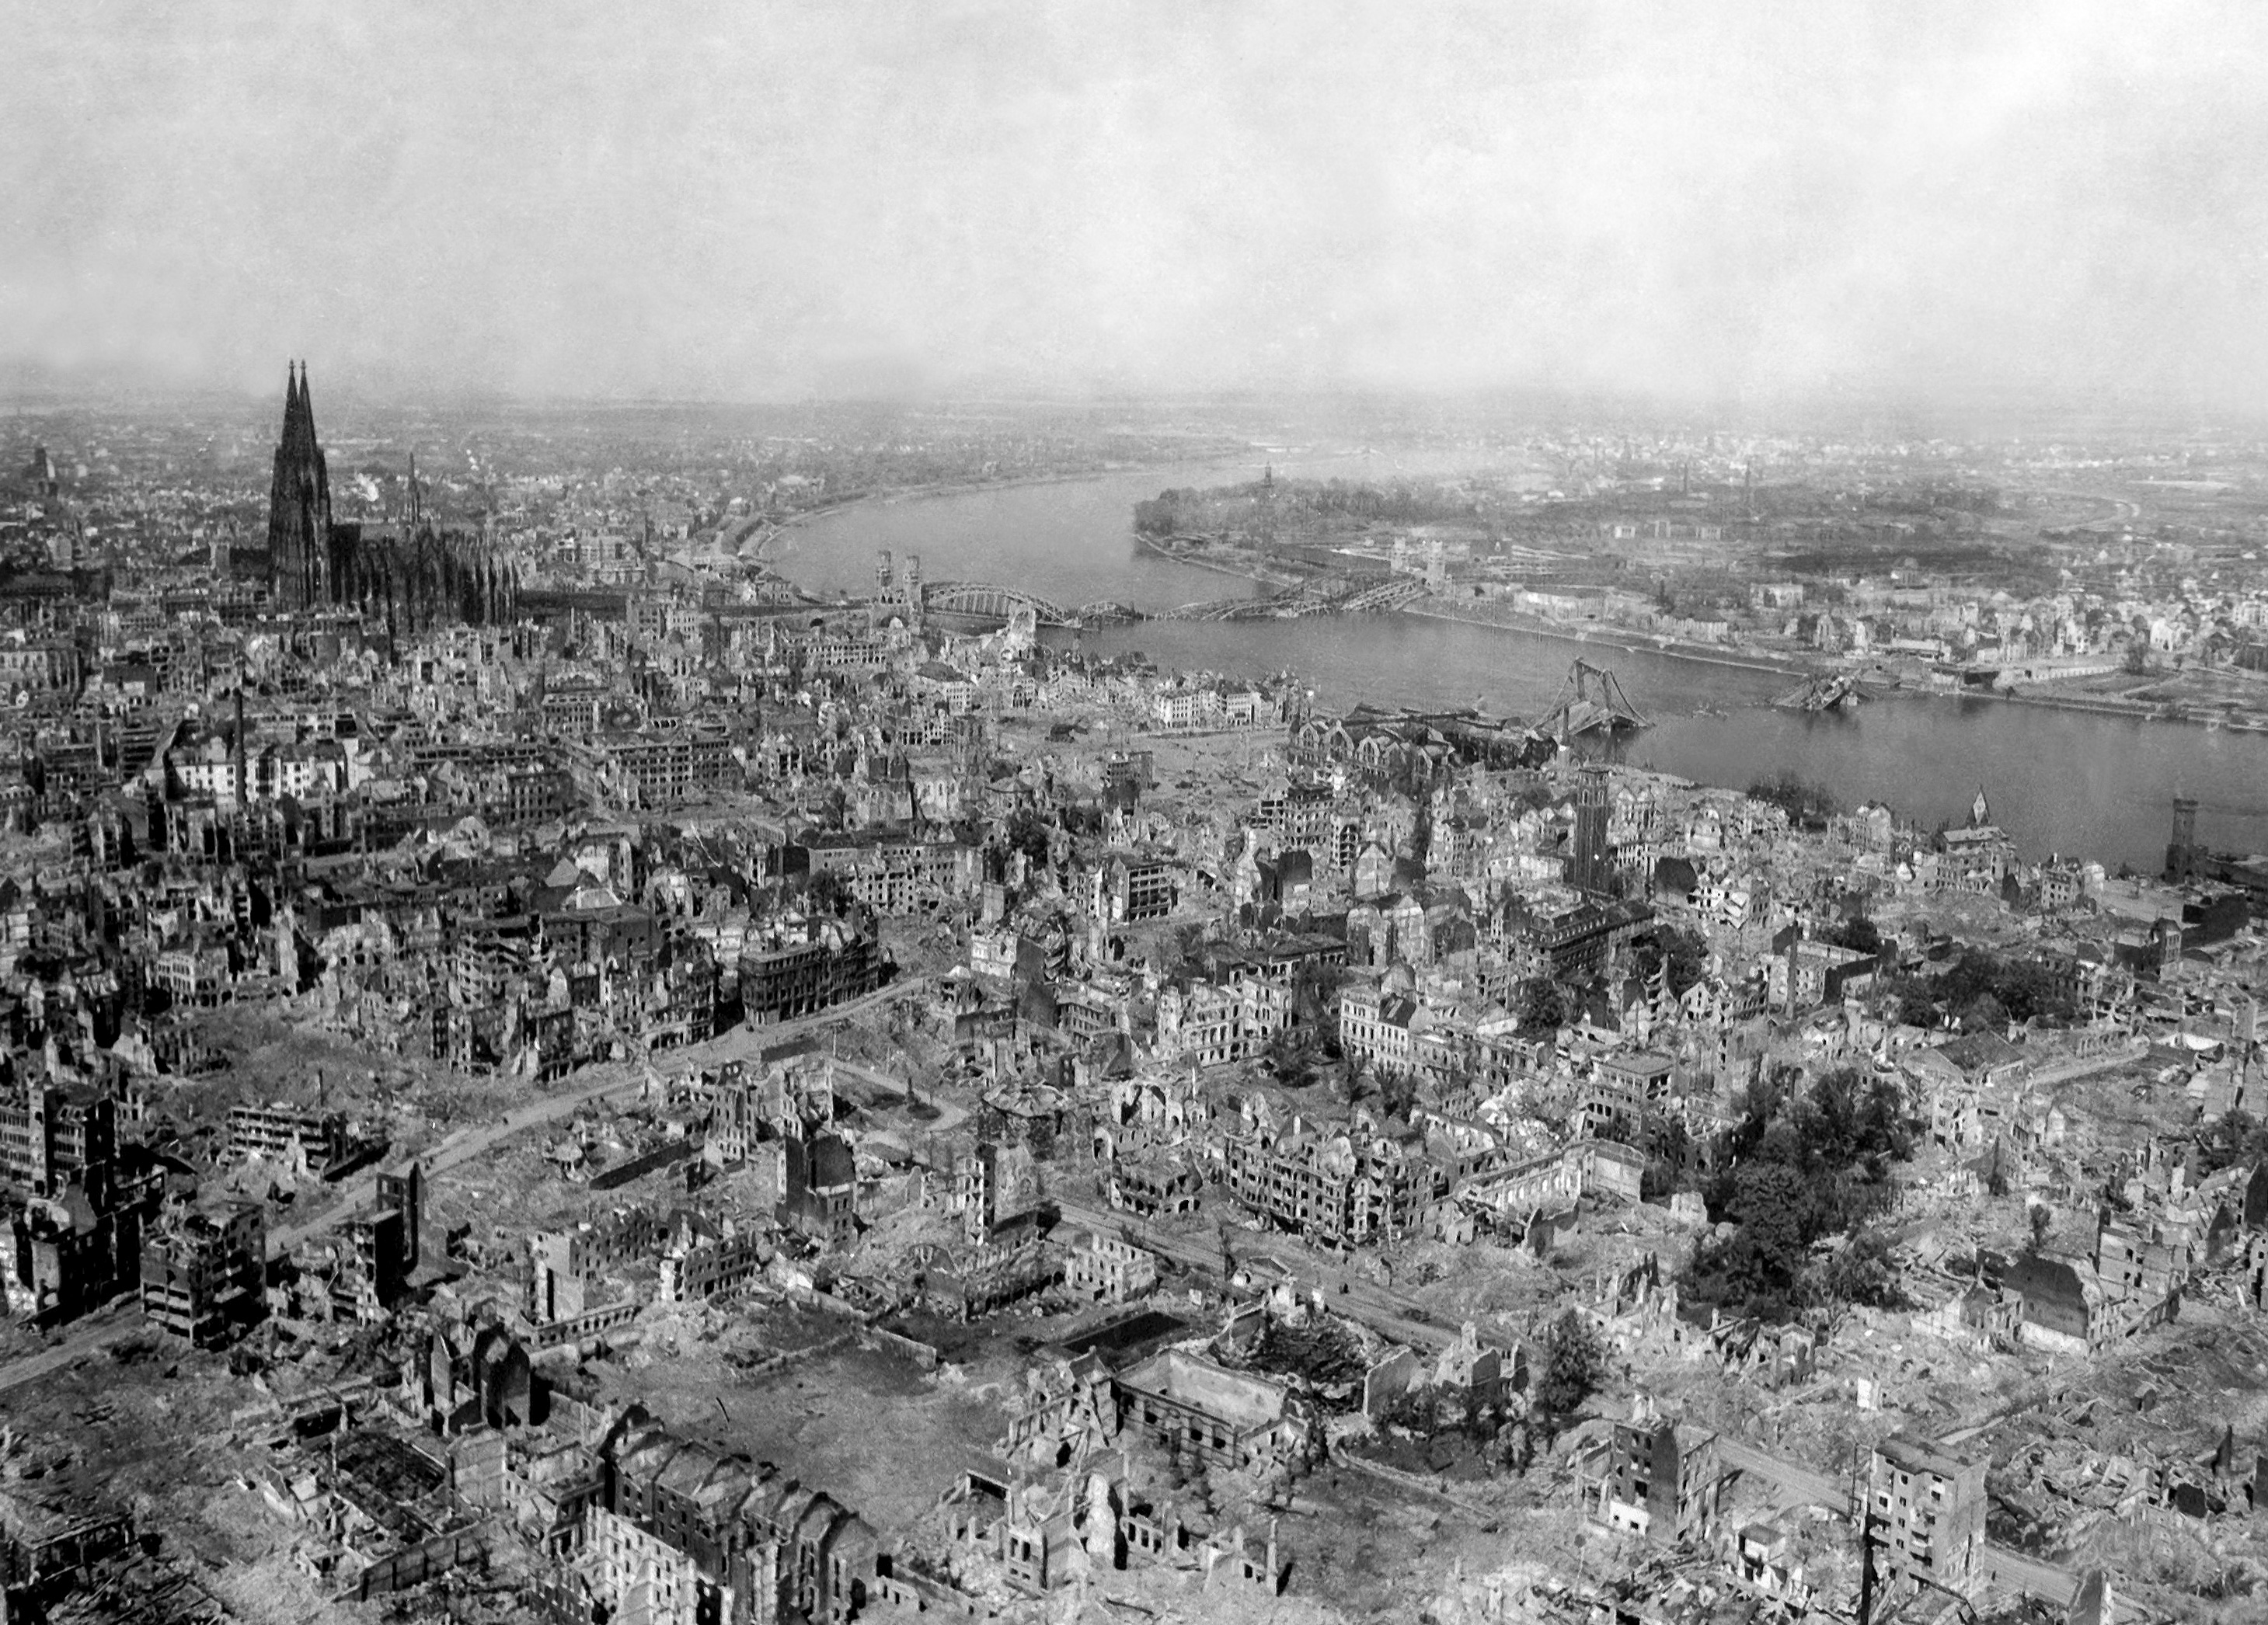
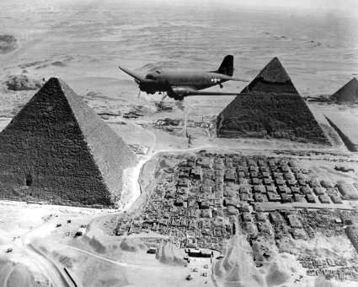
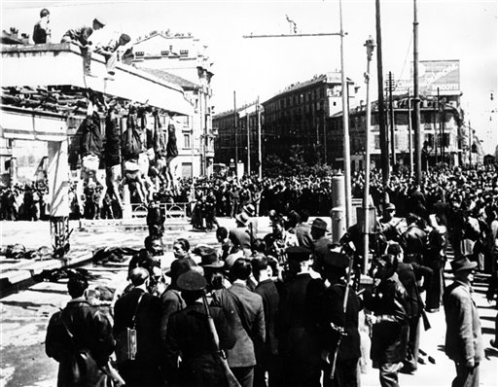
1942 -1943
The war is brought to Germany for the first time.
Allied air forces target industrial plants and cities all across Germany.
Allies force Axis military forces in Northern Africa to surrender.
Allies defeat Italians and depose Benito Mussolini.

Slide 8
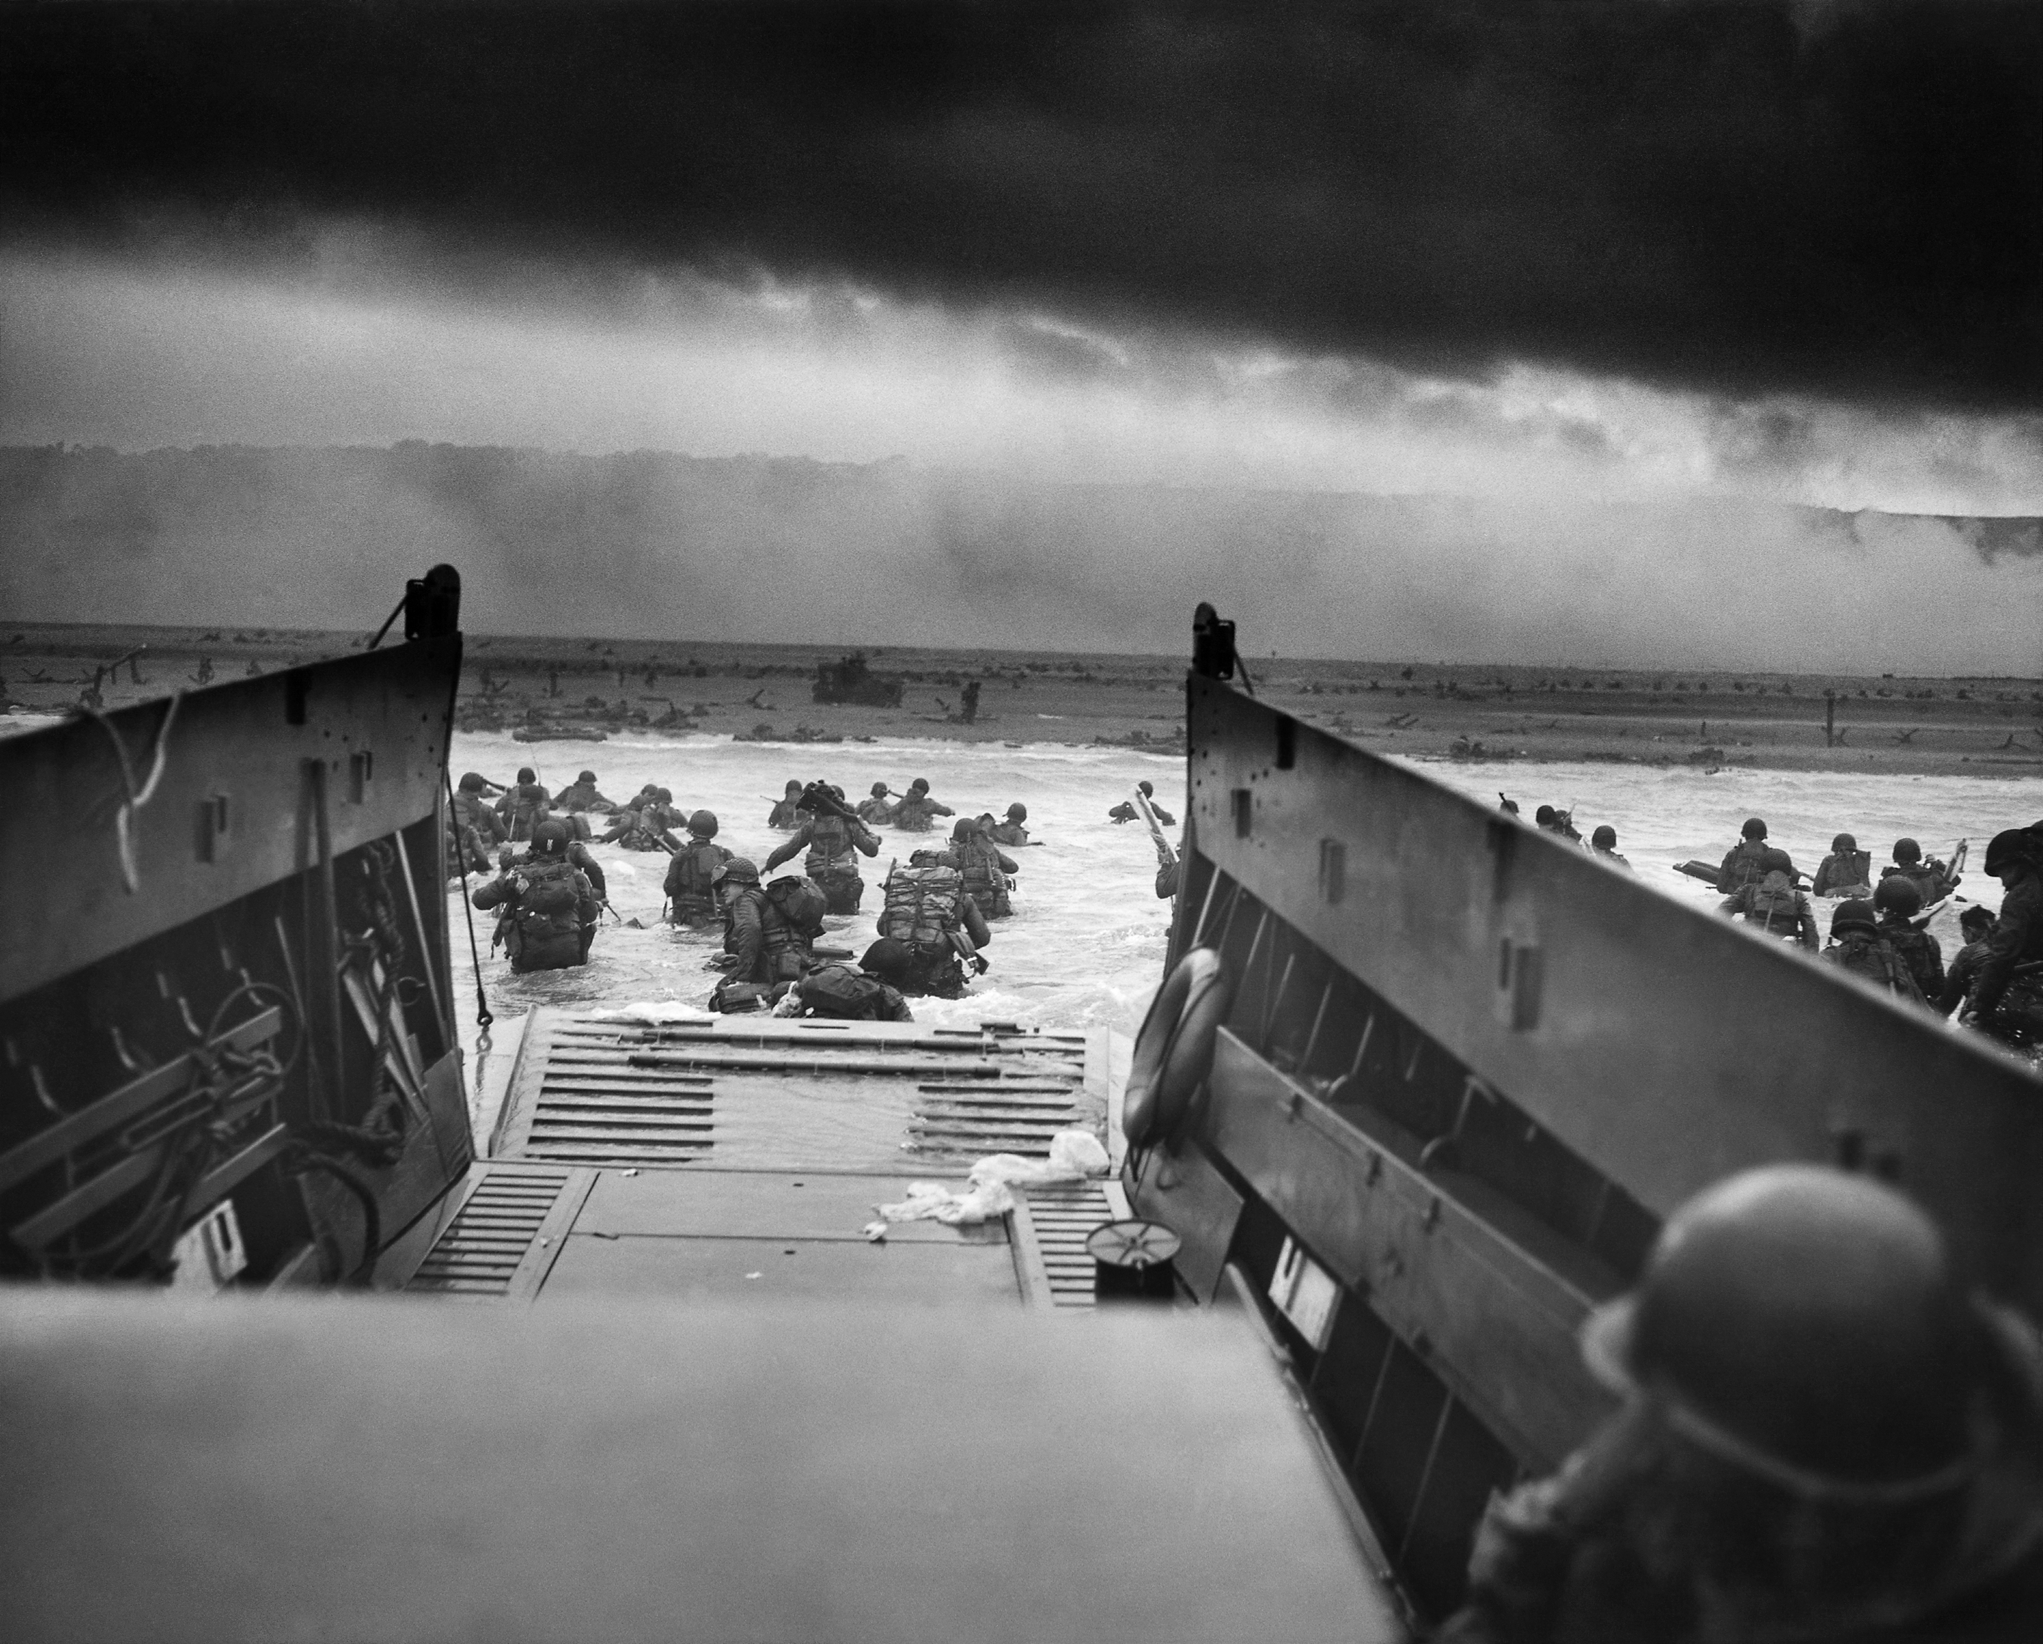
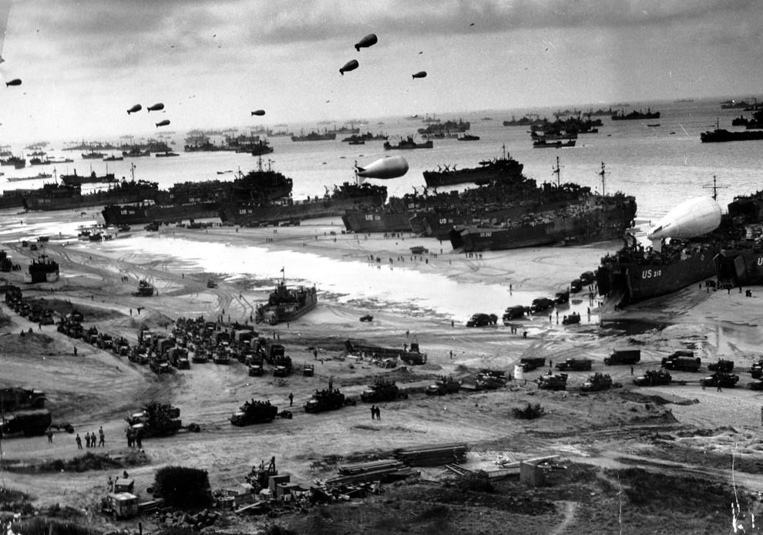
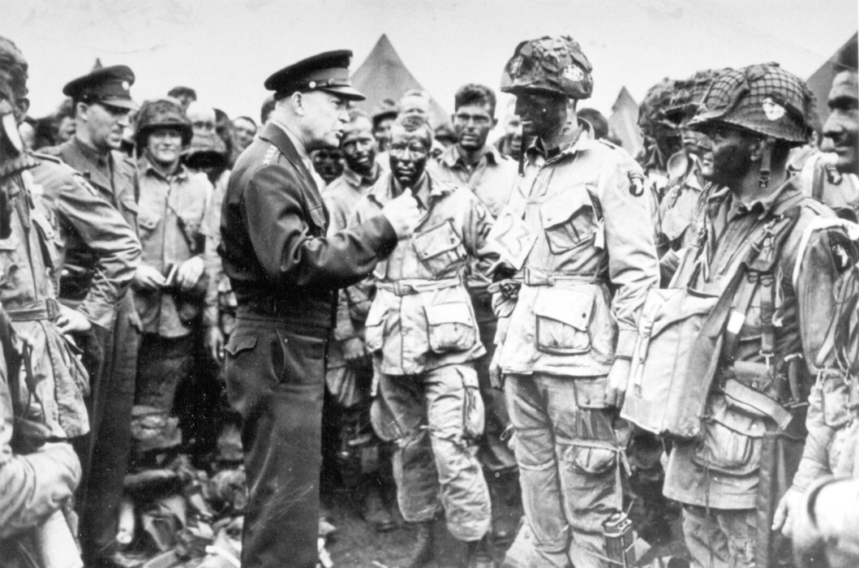
1944
June 6, 1944: D-Day
Allied military operation to liberate northern France.
American forces make their entrance into the European theatre.
September:
U.S. troops cross into western Germany
Soviet troops cross into eastern Germany

Slide 9
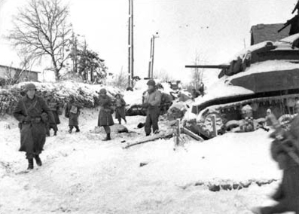
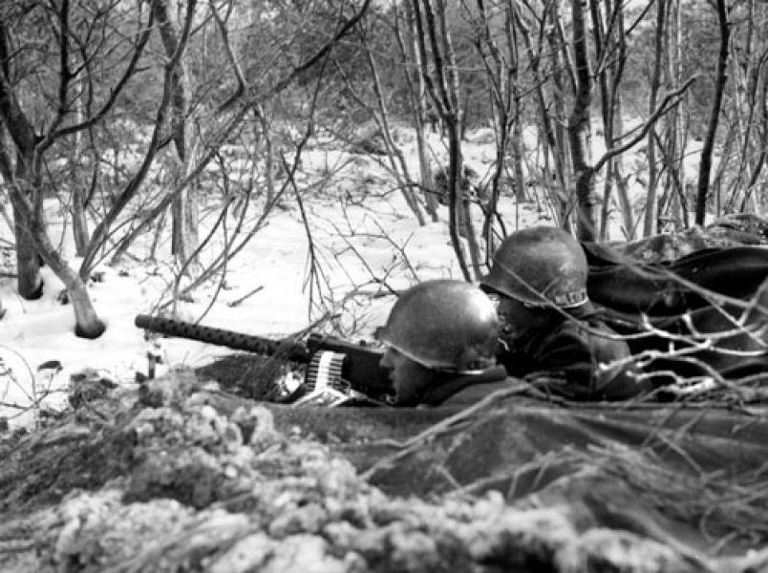
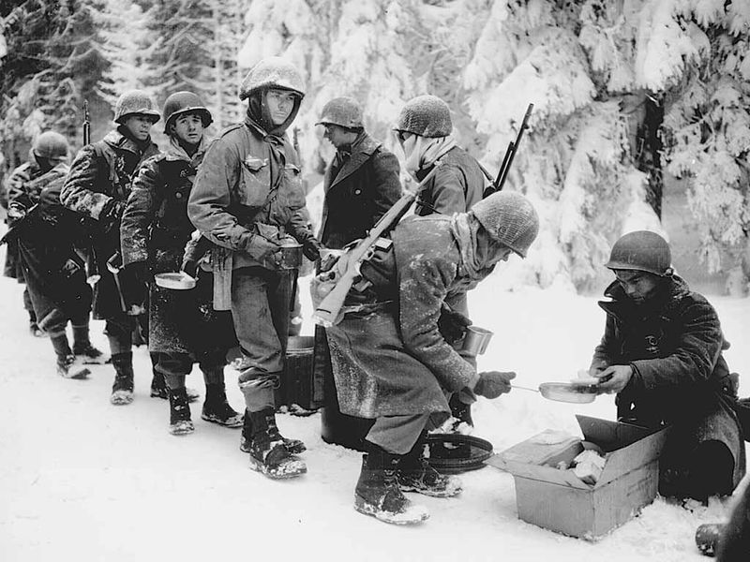
Battle of the Bulge
December 1944 – January 1945
German counterattack in Belgium and northern France.
Outcome: Allied victory
Significance: Hitler’s last offensive attempt to win the war

Slide 10
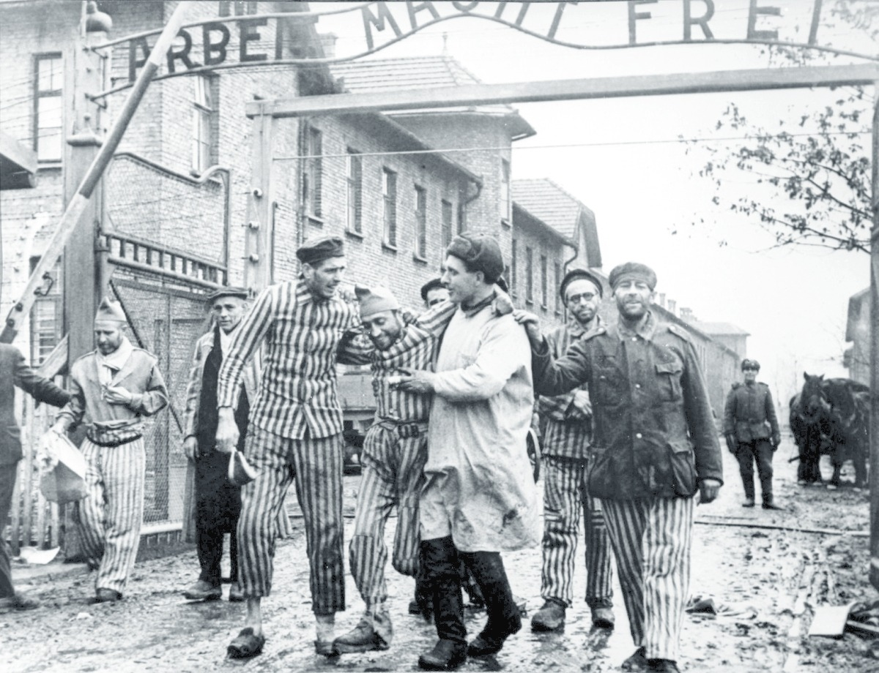
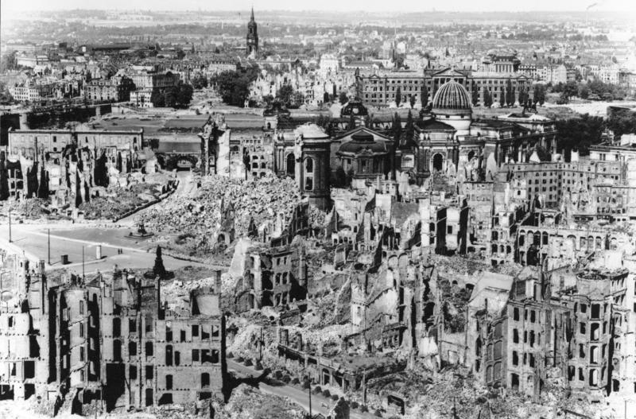
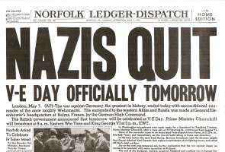
1945
January: Soviets liberate the German controlled territories of Poland and Hungary.
Allies bomb the German city of Dresden killing 35,000 civilians.
April: Soviets surround Germany’s capital at Berlin.
Hitler commits suicide
May 7th, 1945: Germany surrenders to Allied Powers

